Slide 1
installing Zotero on Linux

Slide 2
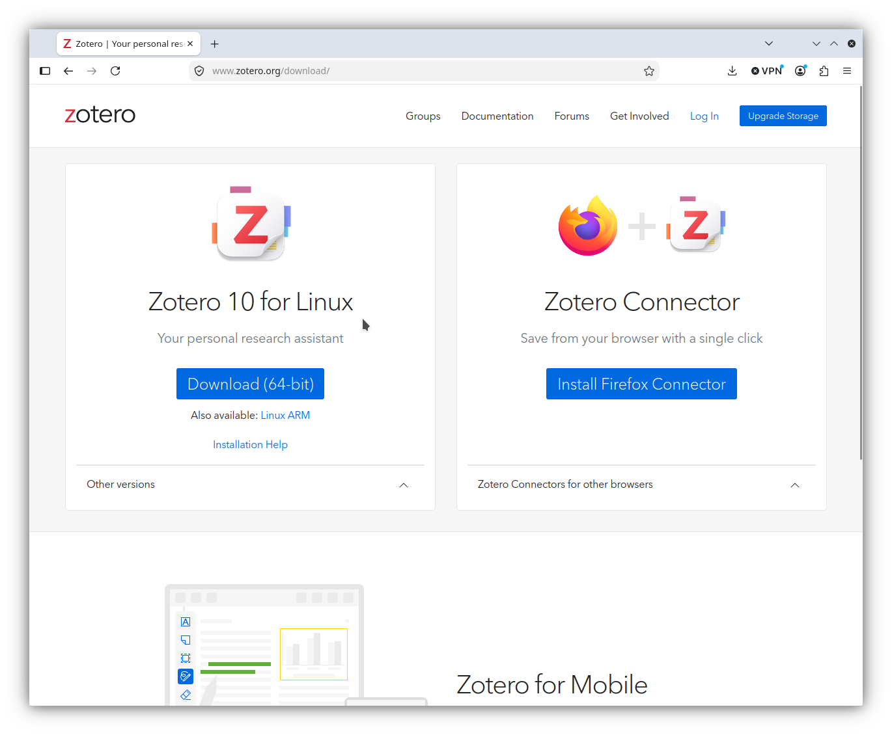
www.zotero.org/download
Notes:
The Zotero download page automatically senses your operating system and your browser.
There are several ways to install Zotero on Linux, depending on your distribution and your own comfort level.
I suggest you start with reading the “Installation Help” page, linked here.

Slide 3
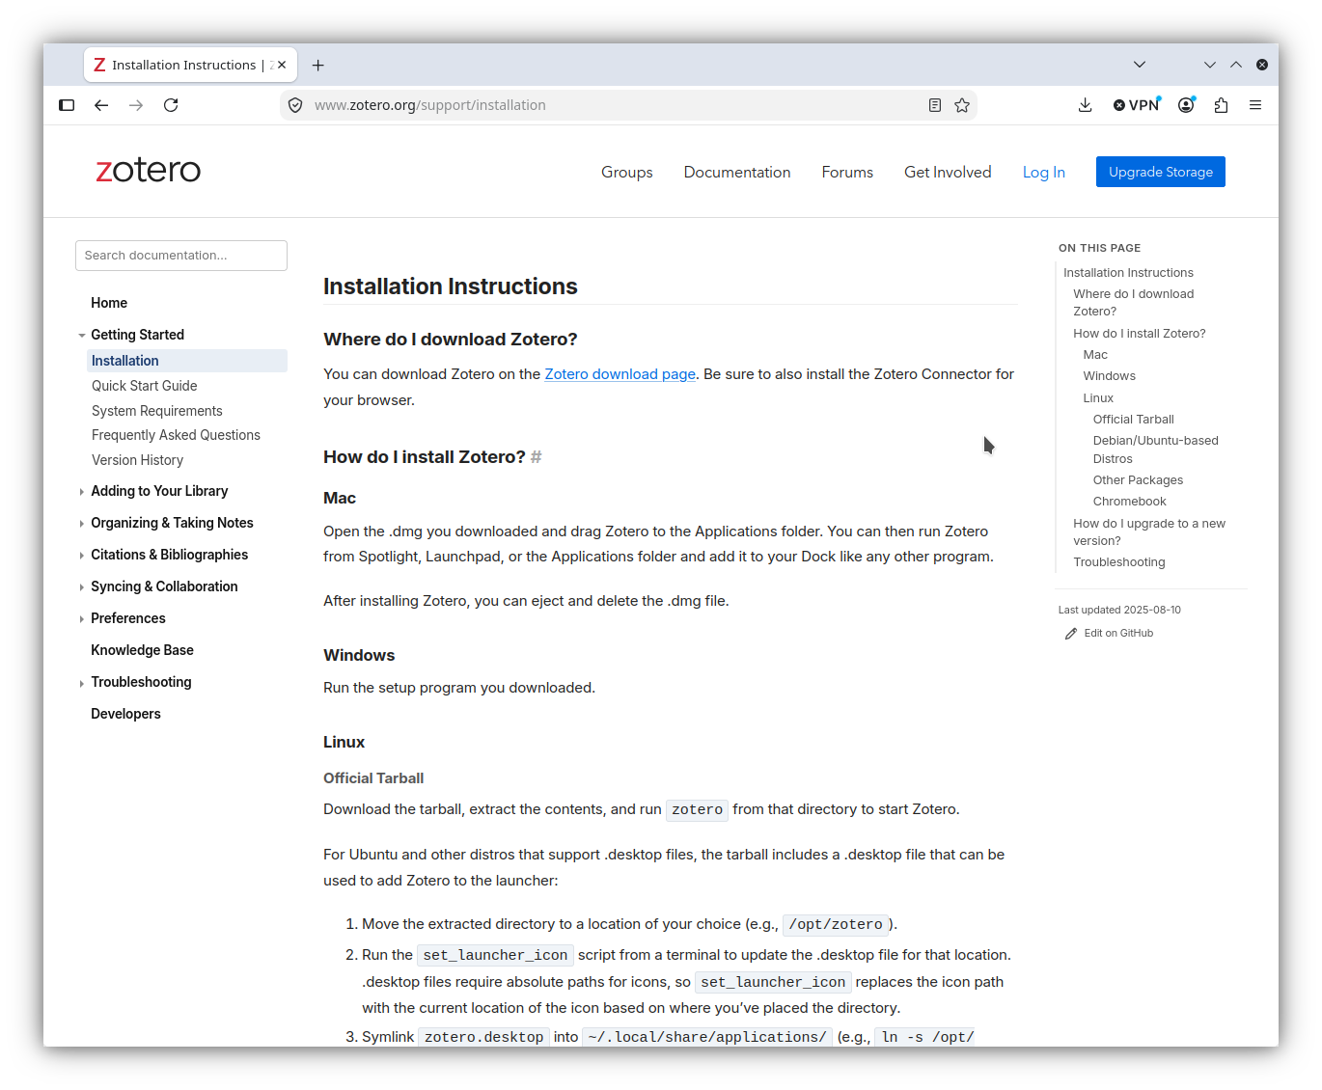
Notes:
- Scroll down to the Linux instructions.

Slide 4
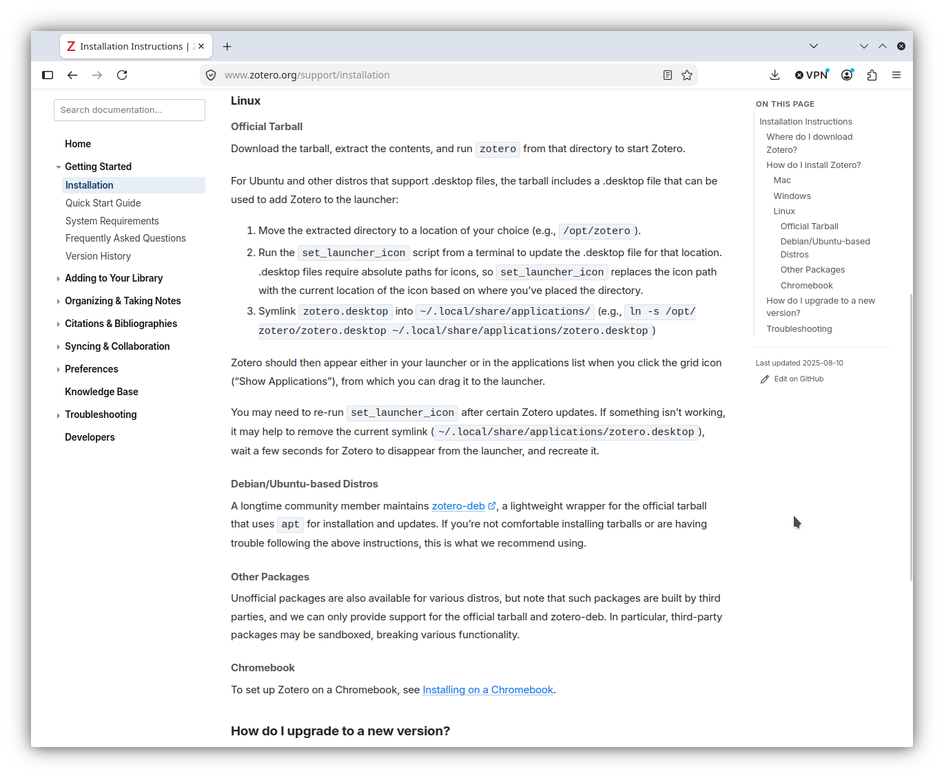
Notes:
Here are the ways you can install.
In the first method, you download the tarball, move it to a desired location, and create some symlinks. If this is not your speed, that’s fine, some distributions have easier ways of installing.
We will start with how to download the tarball.

Slide 5
Notes:
On the Zotero 10 side of the page, click on the blue “Download (64-bit)” button.

Slide 6
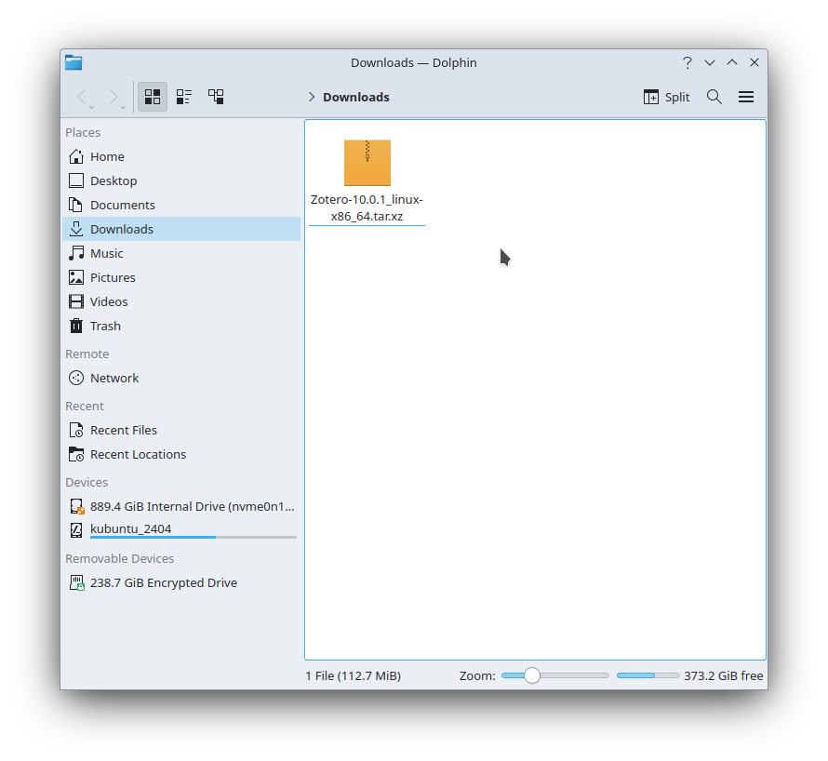
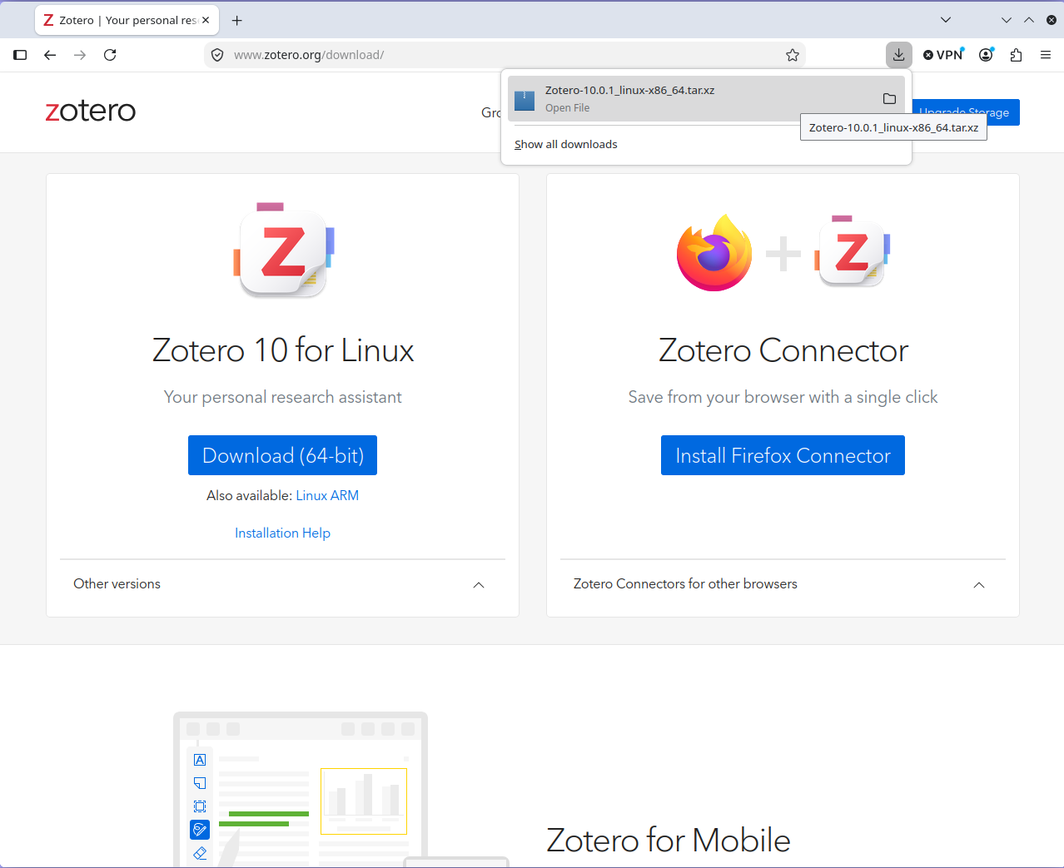
Notes:
When the download dialog shows that your download is complete, click on the folder icon to open you download folder. Inside is your Zotero tarball, which you will move an unzip following the instructions on the “Installation Help” pages.
Don’t worry if the filename you download is not exactly the same as the one shown here; it will change as newer versions are released.

Slide 7
Notes:
Once you’ve downloaded the tarball, follow this first set of instructions.
If you don’t want to do that, you can use distribution-specific installation methods. I use Kubuntu, an Ubuntu/Debian variant distribution. If you do as well, click on the link to the third-party installation script maintainer linked here.

Slide 8
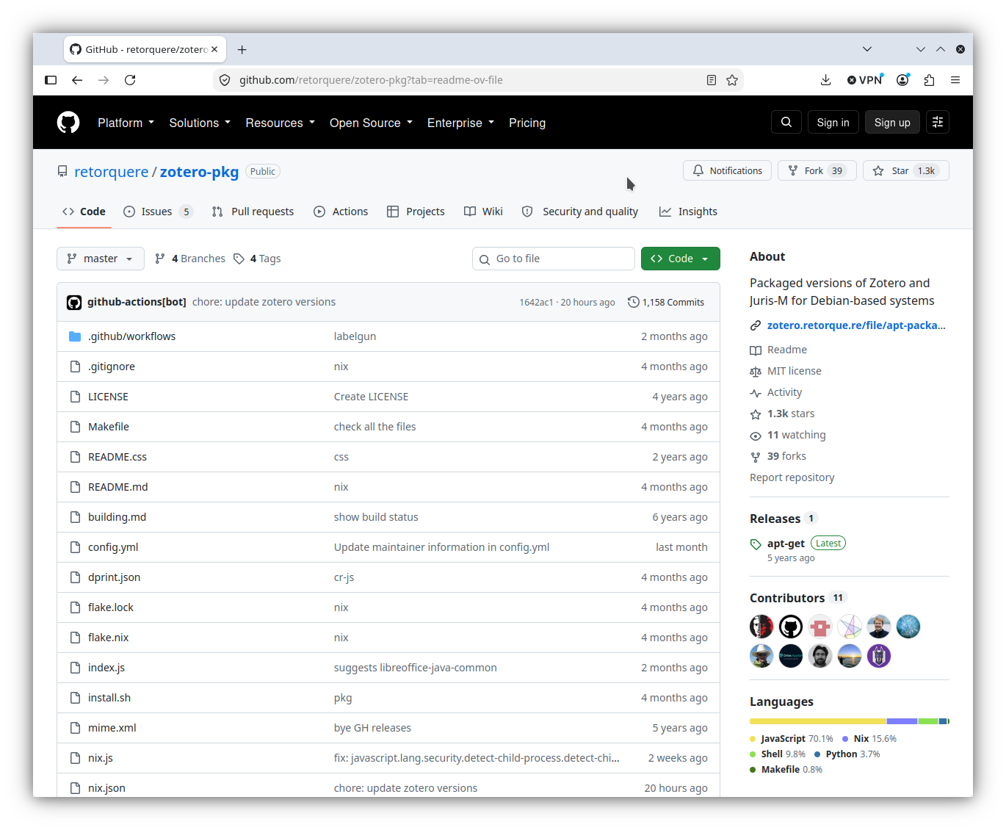
Notes:
This brings you to the github page for the script maintainer.
Open the README.md file (it is in markdown format, so just about any editor can read it.

Slide 9
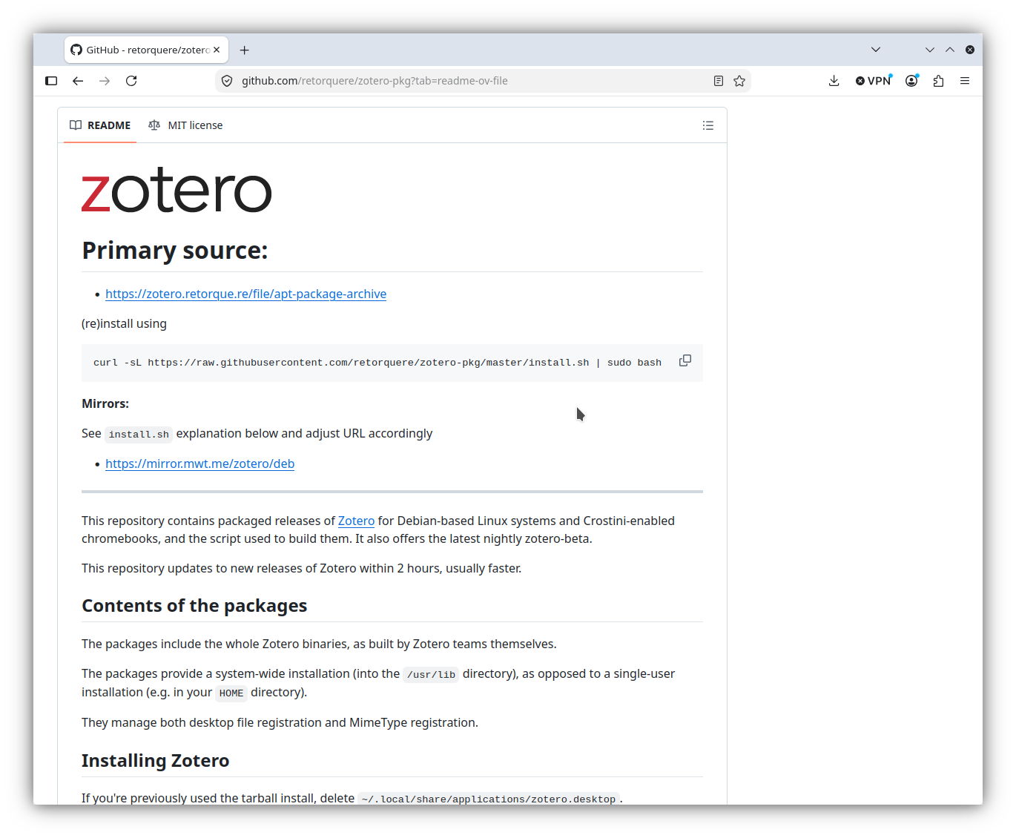
Notes:
- This is the README.md page. Scroll down to the “Installing Zotero” portion.

Slide 10
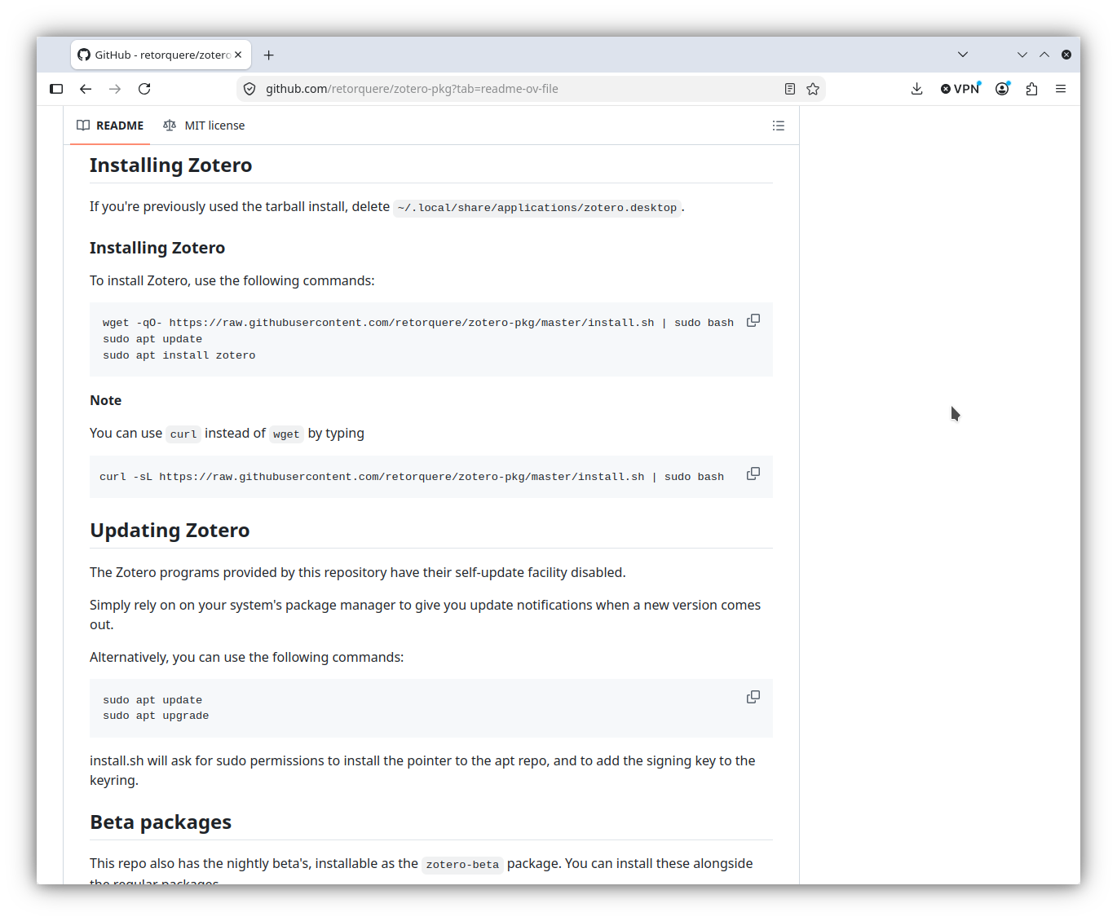
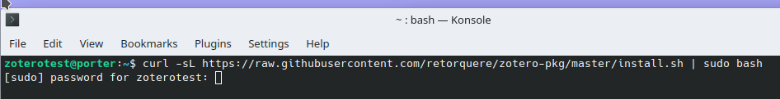
Notes:
Open a shell terminal (I use konsole) and use either the wget or curl instructions.
I used the curl commands
Once I gave it my superuser password, it installed Zotero and set up all the shortcuts and menu entries.
Zotero running on Linux looks just like Zotero running on Windows or Mac.

Slide 11
Notes:
- Installing the Firefox connector involves opening the download page in Firefox and then clicking on the blue “Install Firefox Connector” button.

Slide 12
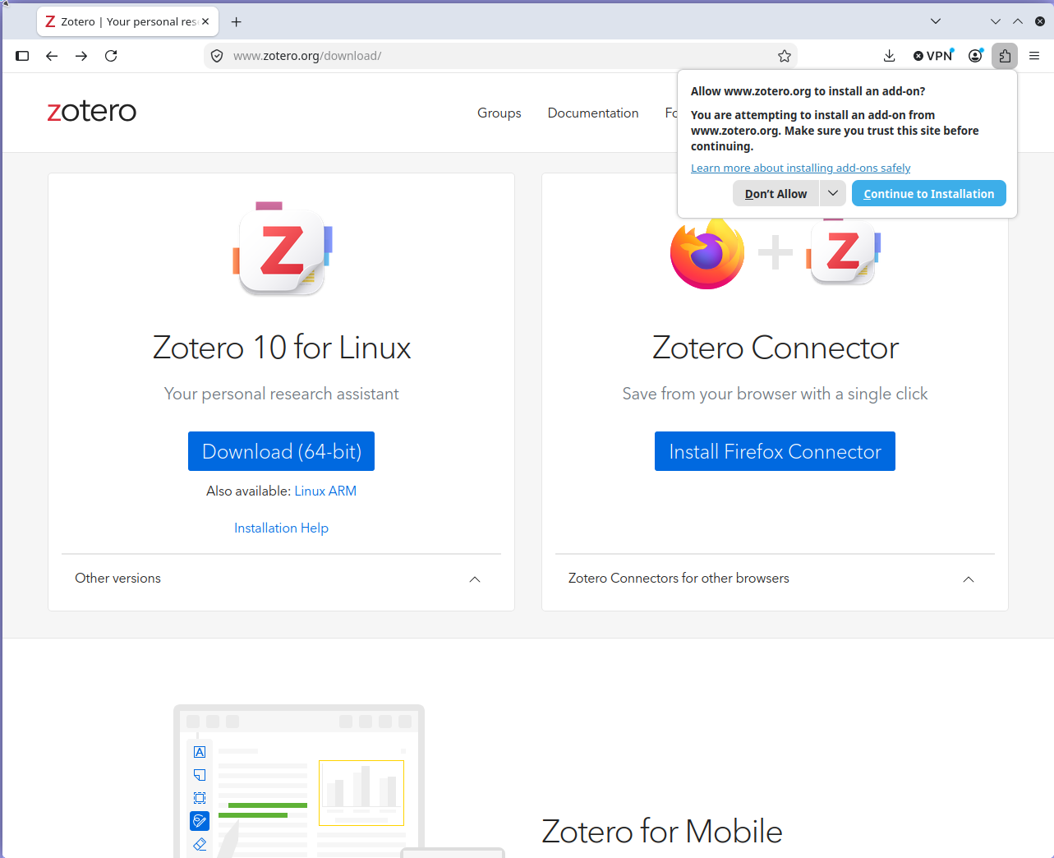
Notes:
- When the dialog box pops up that asks if you are sure, click on the “Continue to Installation” button.

Slide 13
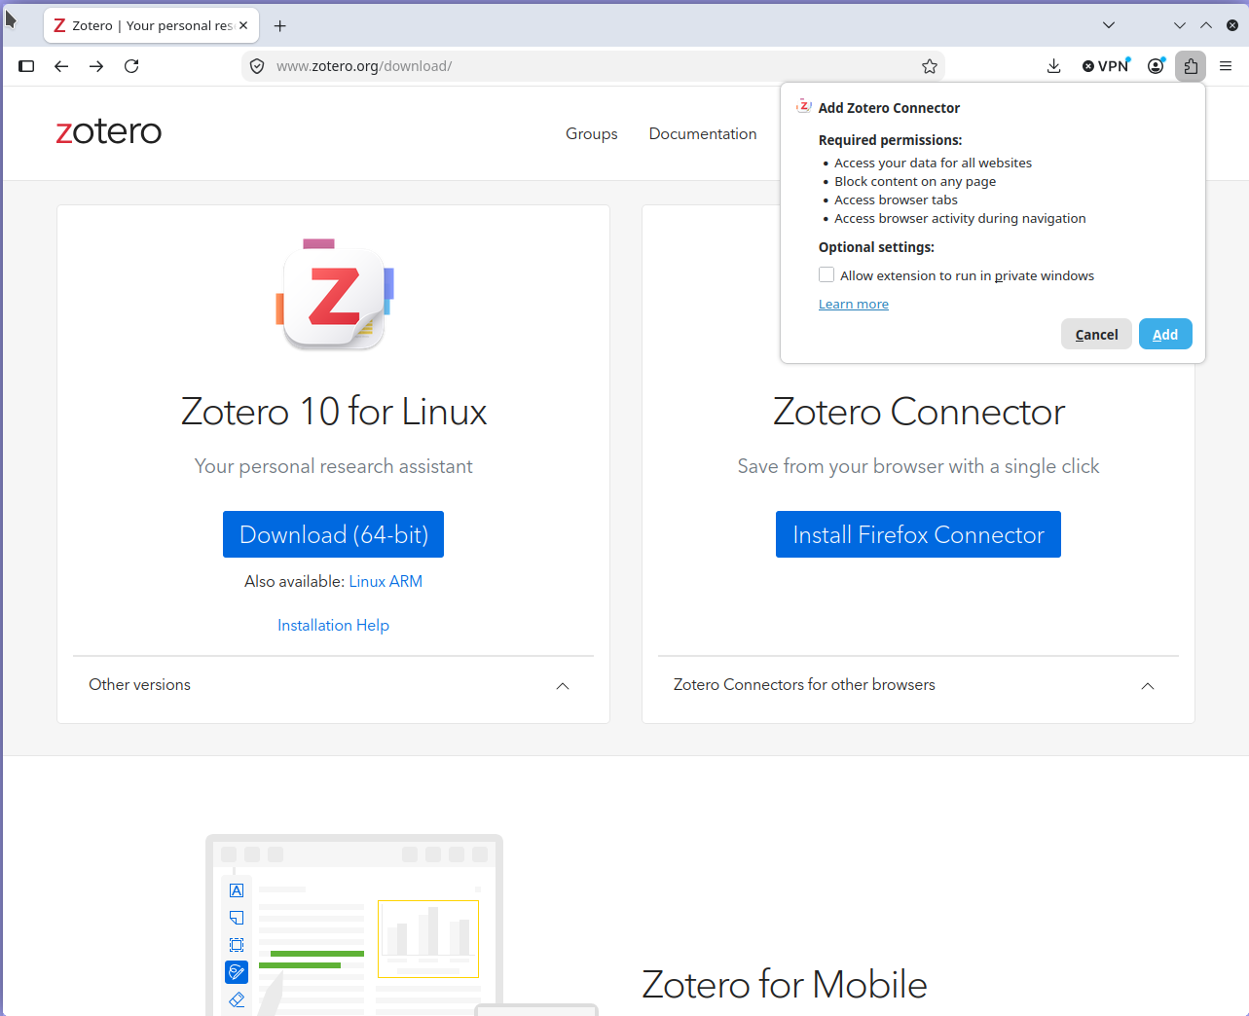
Notes:
It then shows you what the add-on will be able to do, all of which is necessary for it to function. You can also allow it to run inside private windows if you want.
Click on the blue “Add” button.

Slide 14
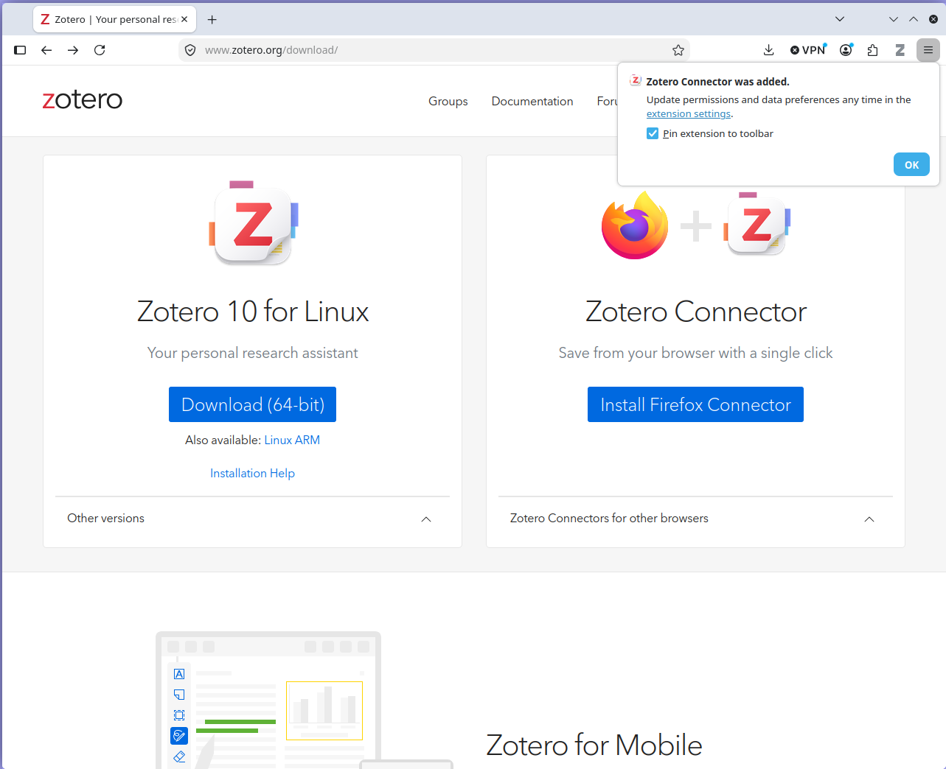
Notes:
A dialog box informs you that it has been added and offers you a chance to pin the extension icon to the toolbar. You want to do this, so make sure you check the box.
Click the blue “Add” button.

Slide 15
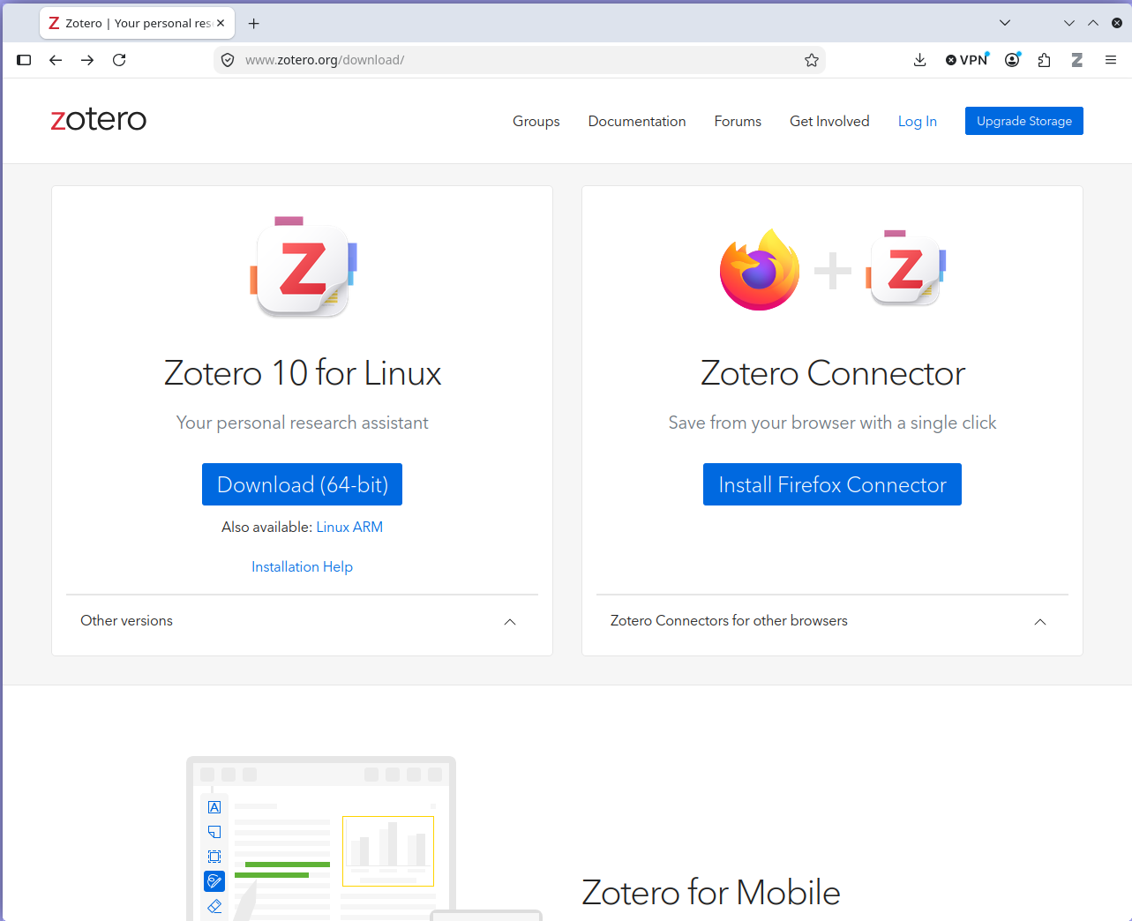
Notes:
Note the “Z” Zotero icon pinned to the toolbar. Firefox is now ready to go.

Slide 16
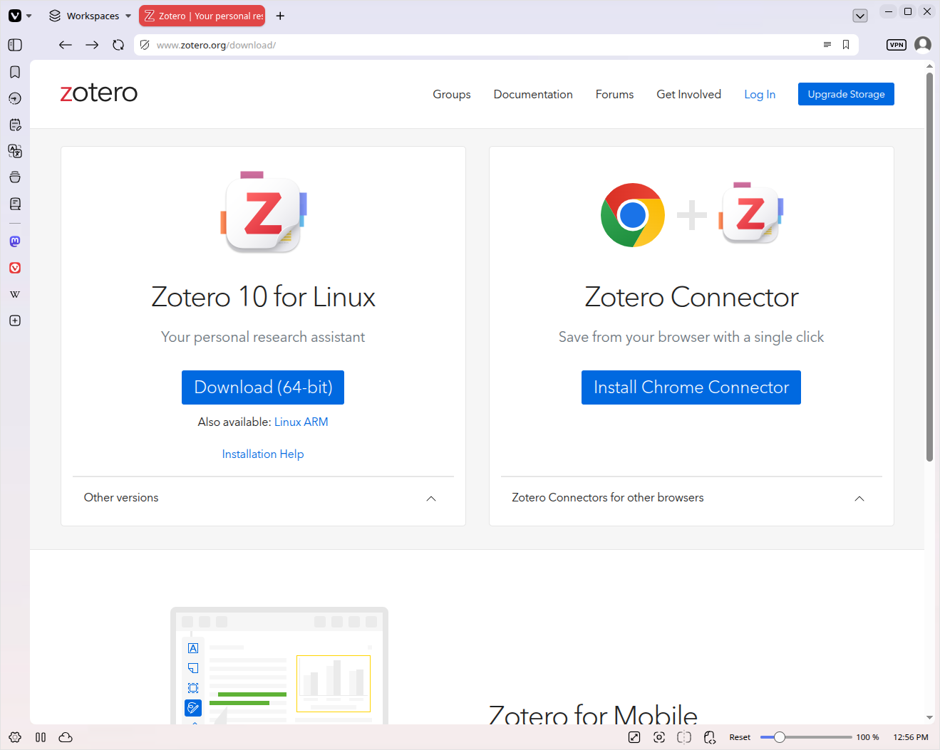
Notes:
You may want to use a chromium-based browser like Vivaldi, Opera, Brave, or even ungoogled Chromium. I do not recommend that you use Google Chrome itself, as it is a privacy nightmare.
Chromium is the open source base code that Google Chrome uses, but without any proprietary additions. It is also the base for many other browsers. These can each add their own proprietary additions and web services to their versions.
Vivaldi is fairly good from a privacy and AI standpoint, as is Opera.
Click on the blue “Install Chrome Connector” button to start.

Slide 17
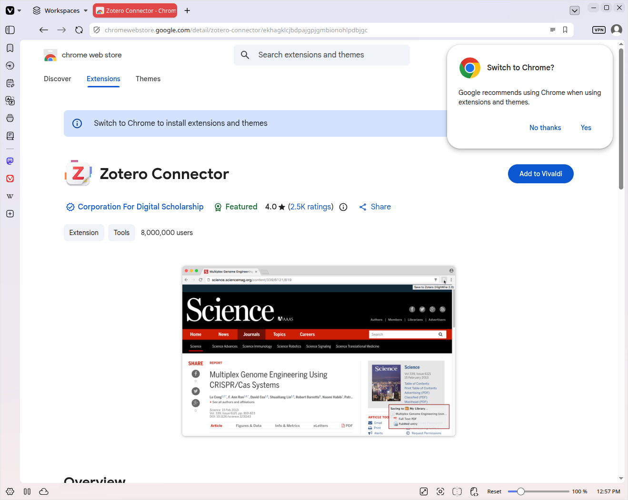
Notes:
- They really want you to use Chrome. It is not necessary, and also not a good idea. Just click “No thanks” and then the blue “Add to Vivaldi” button.

Slide 18
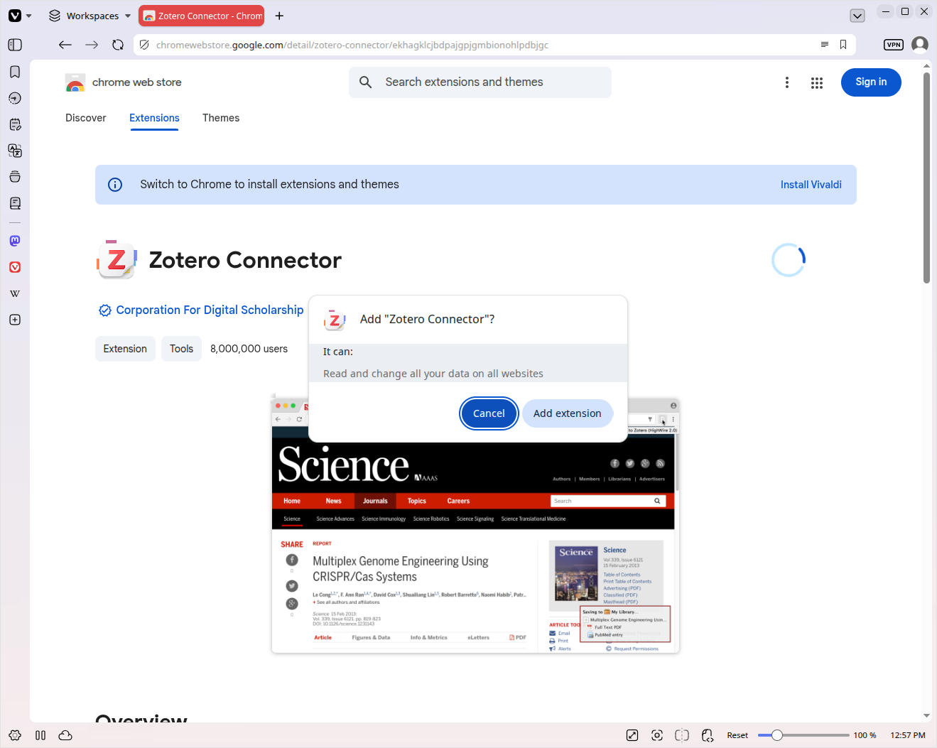
Notes:
This dialog shows you what you are permitting the add-on to do.
Click the light blue “Add extension” button.

Slide 19
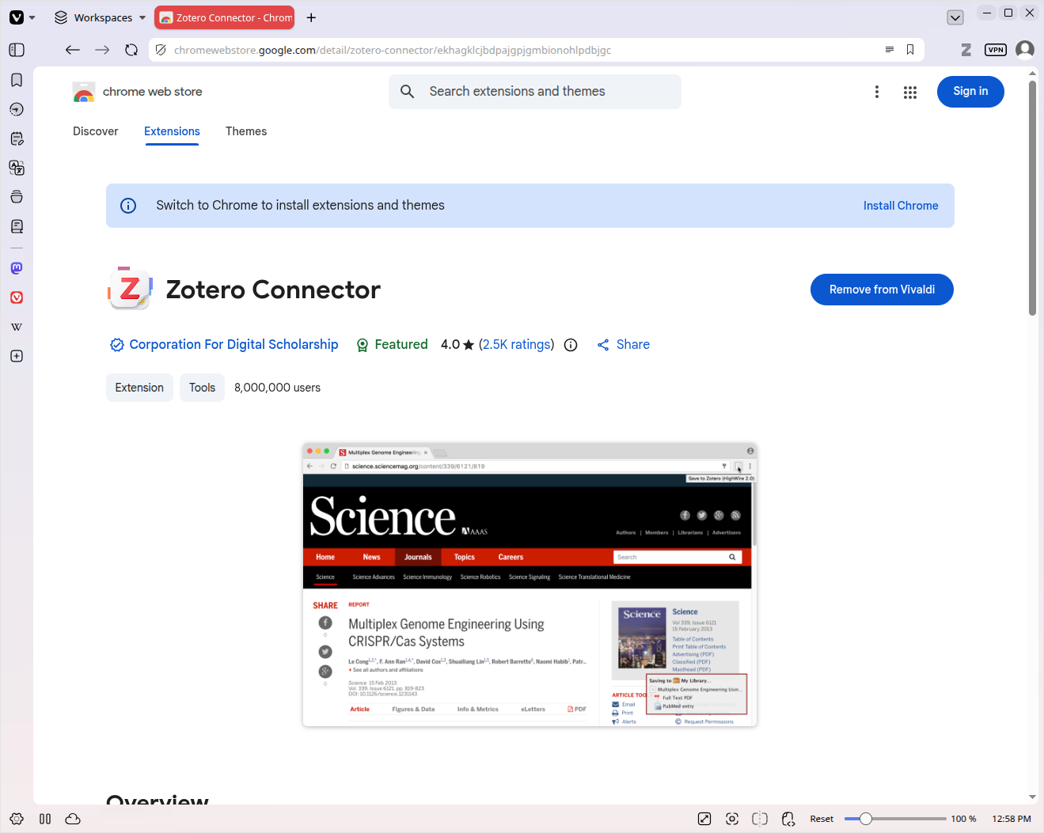
Notes:
- You can see the “Z” Zotero icon in the toolbar. On some chromium-based browsers, you will need to click on the extensions icon, and then click on a push-pin icon next to the Zotero Connector listing in order to pin the icon to the toolbar. You want to do this.

