Slide 1
installing Zotero on Mac

Slide 2
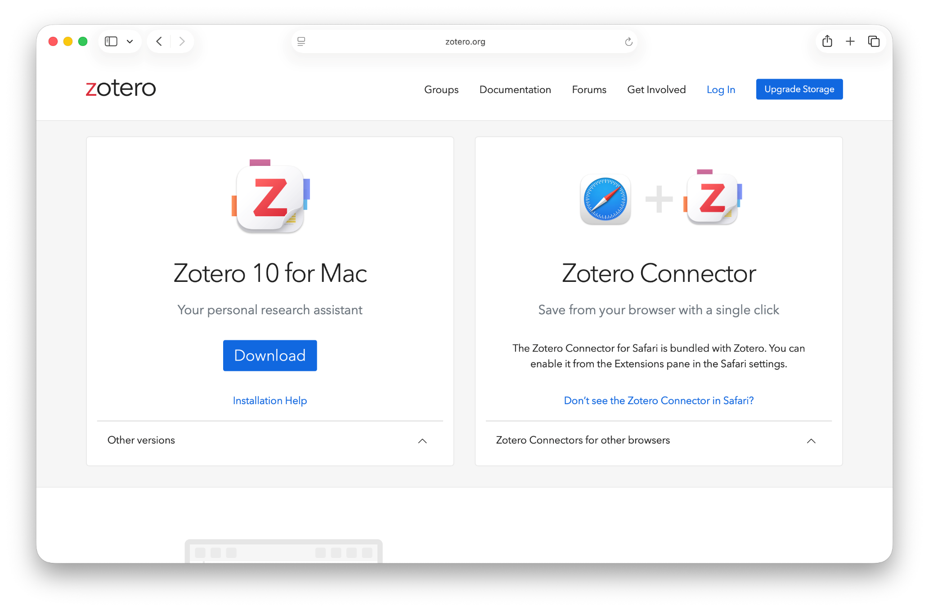
www.zotero.org/download
Notes:
This is the download page at the Zotero website. It automatically recognizes your operating system and web browser.
Click on the blue “Download” button.

Slide 3
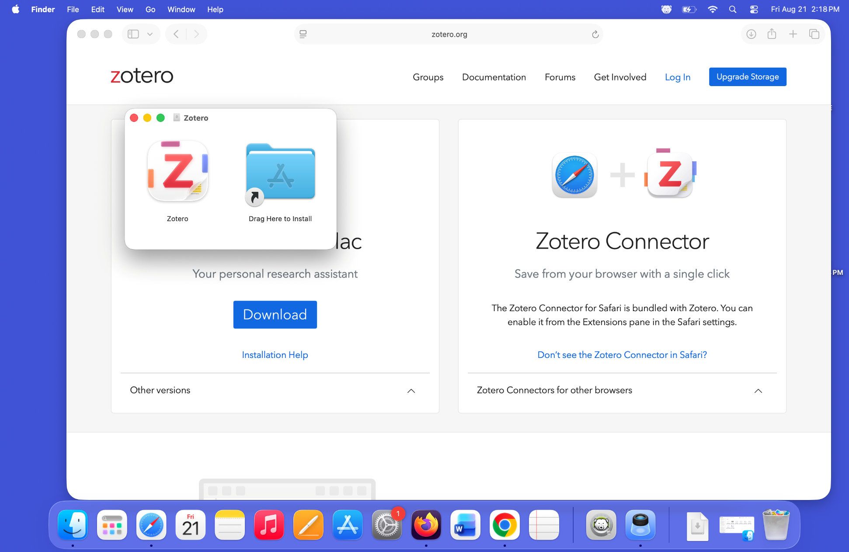
Notes:
- The installer opens a window for you to drag and drop the Zotero program icon onto the install an app folder. You should do this.

Slide 4
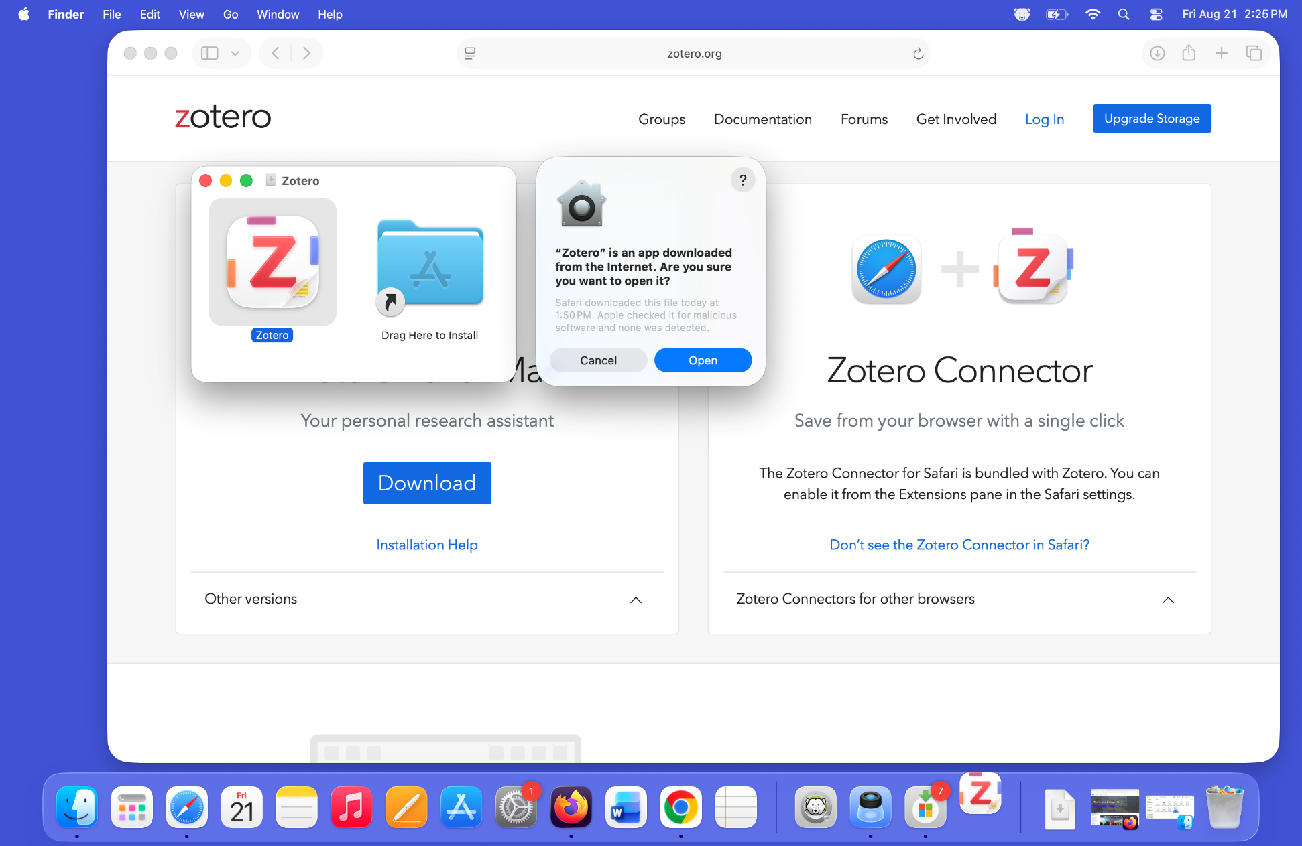
Notes:
- Since you downloaded this app from the internet, MacOS will ask you if you are sure you want to open it. Click on the blue “Open” button.

Slide 5
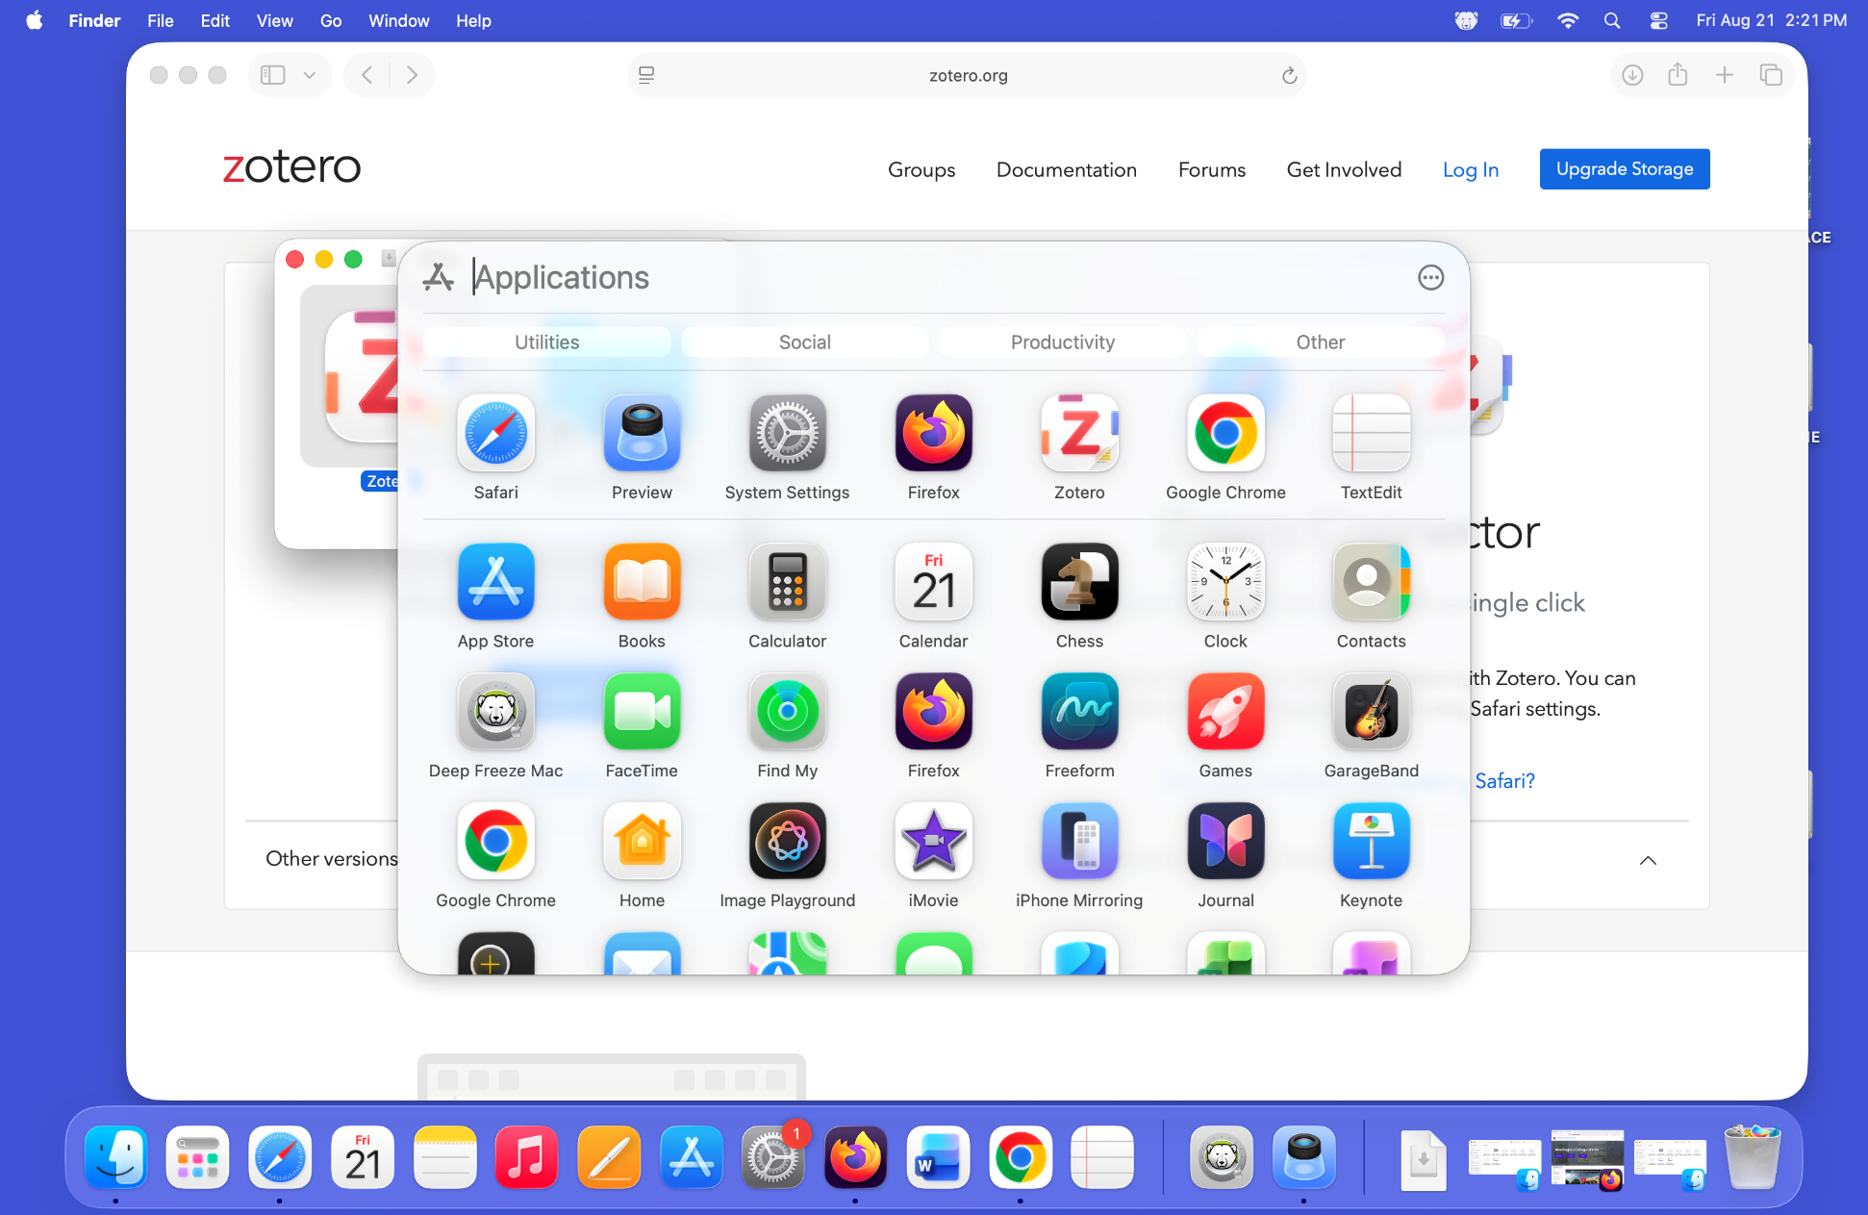
Notes:
- Now, when you open your apps folder, Zotero is there. Click on it to start Zotero.

Slide 6
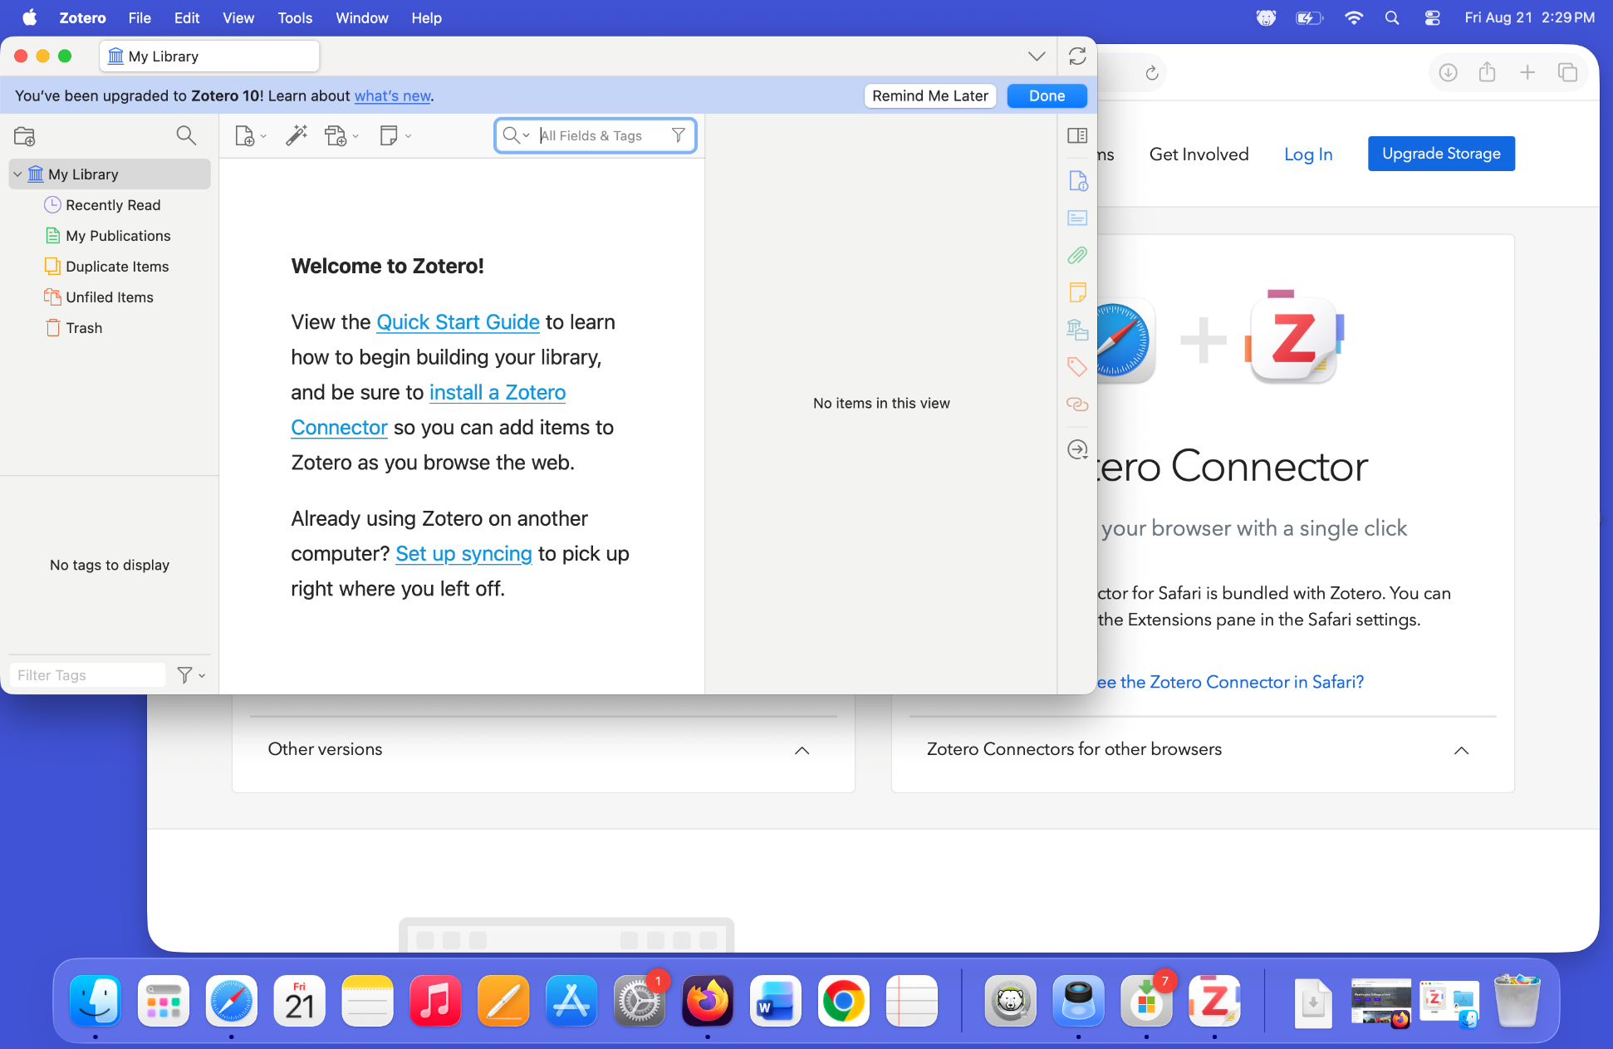
Notes:
This is the standard empty Zotero database that you get when you first install Zotero.
Click on the Zotero entry in the App menu bar/

Slide 7
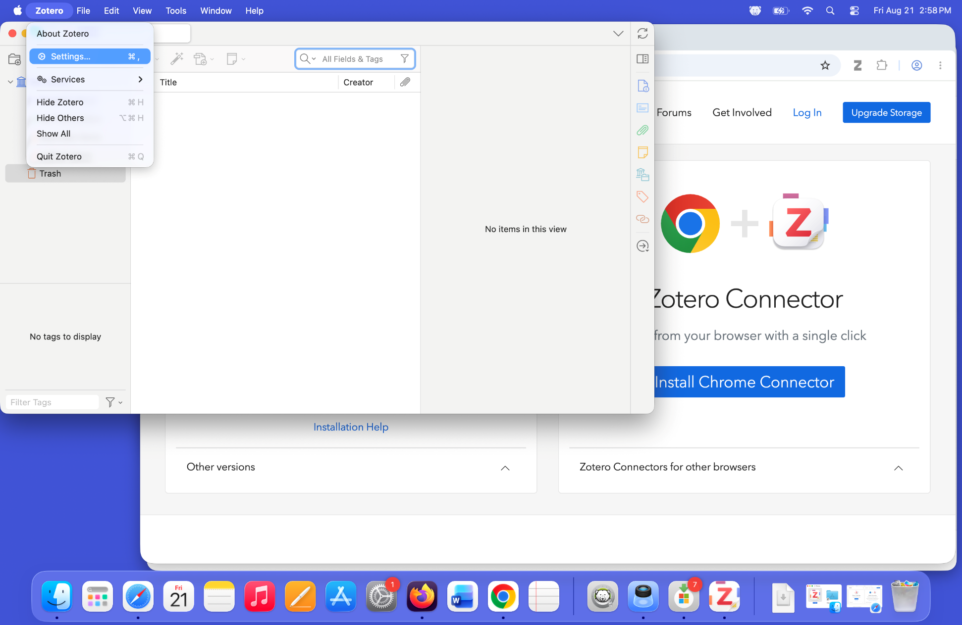
Notes:
- Click on “Settings” in the Zotero app menu bar pull down menu.

Slide 8
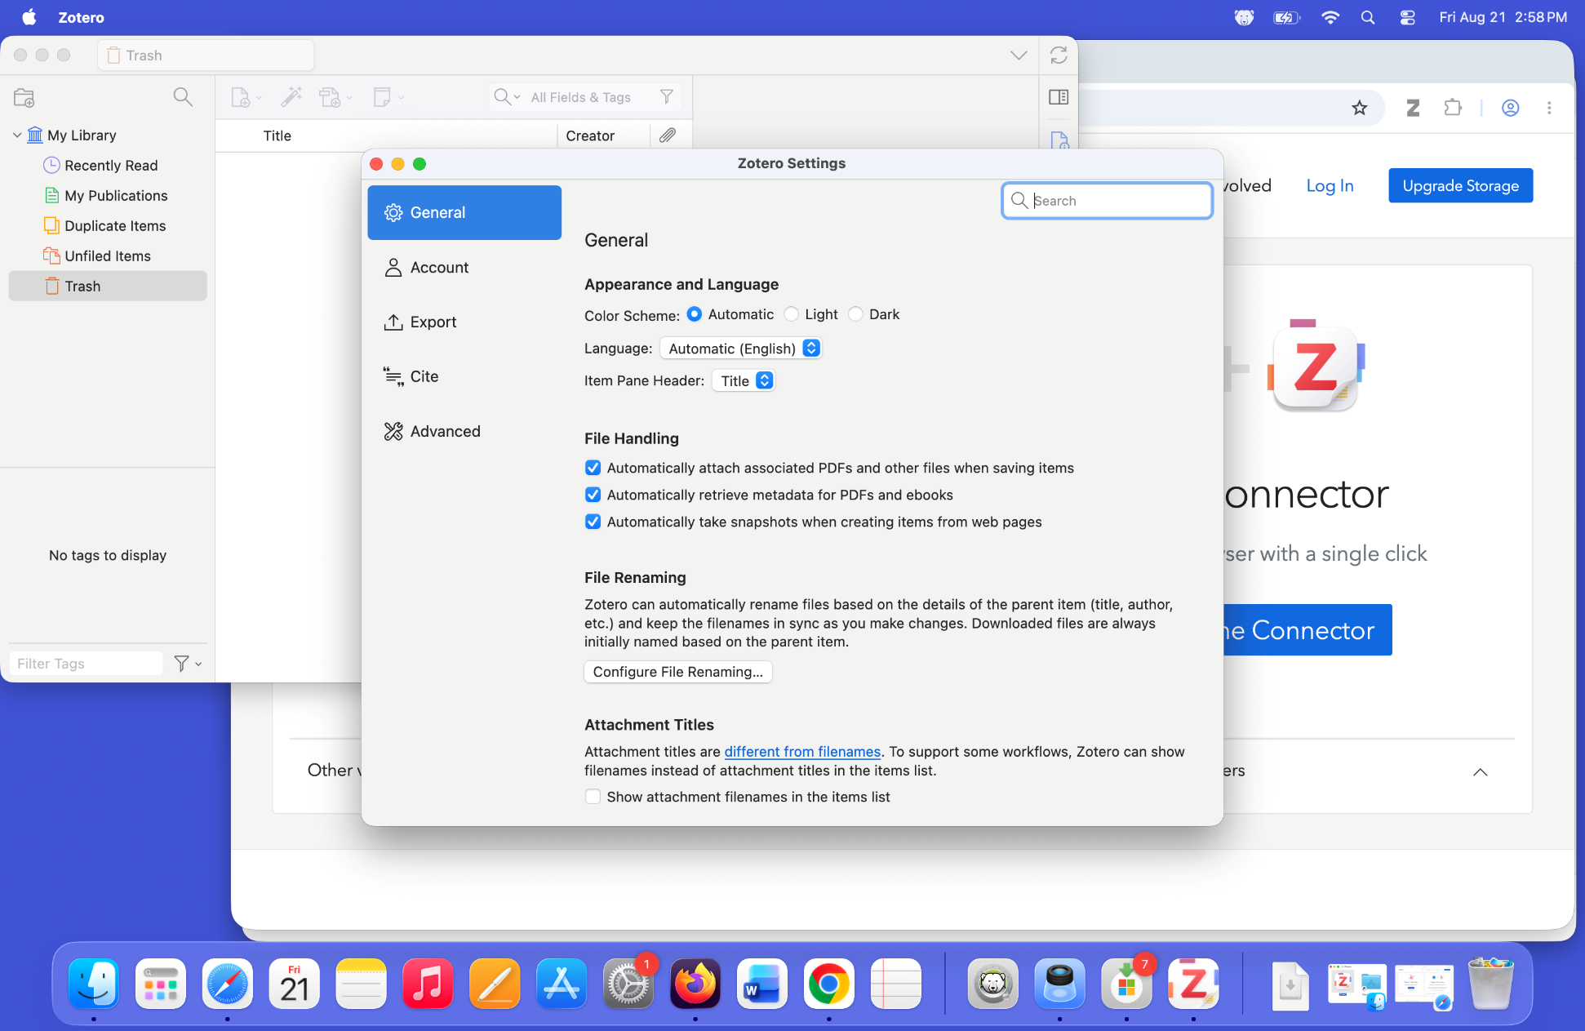
Notes:
- This is the standard Zotero setting dialog common to all operating systems. Follow the generic Zotero installation/configuration instructions from this point.

Slide 9
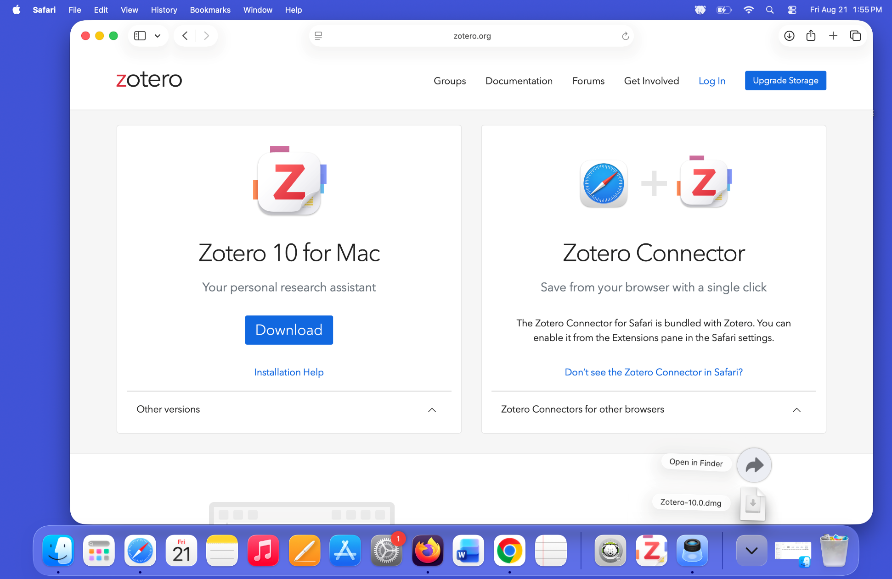
Notes:
- If you are using Safari as your browser, the connector is already built in. You just need to enable it in the Safari settings.

Slide 10
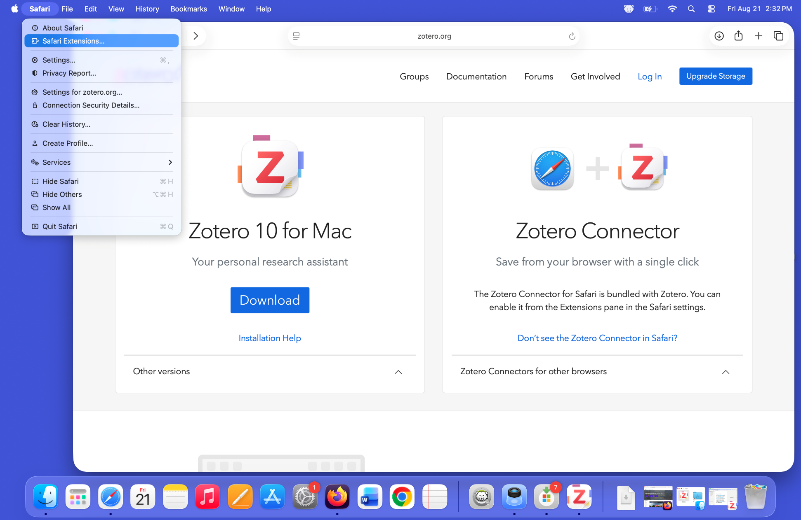
Notes:
- In the Safari app menu bar, click on the “Safari“pull-down menu, and then select “Safari Extensions…”

Slide 11
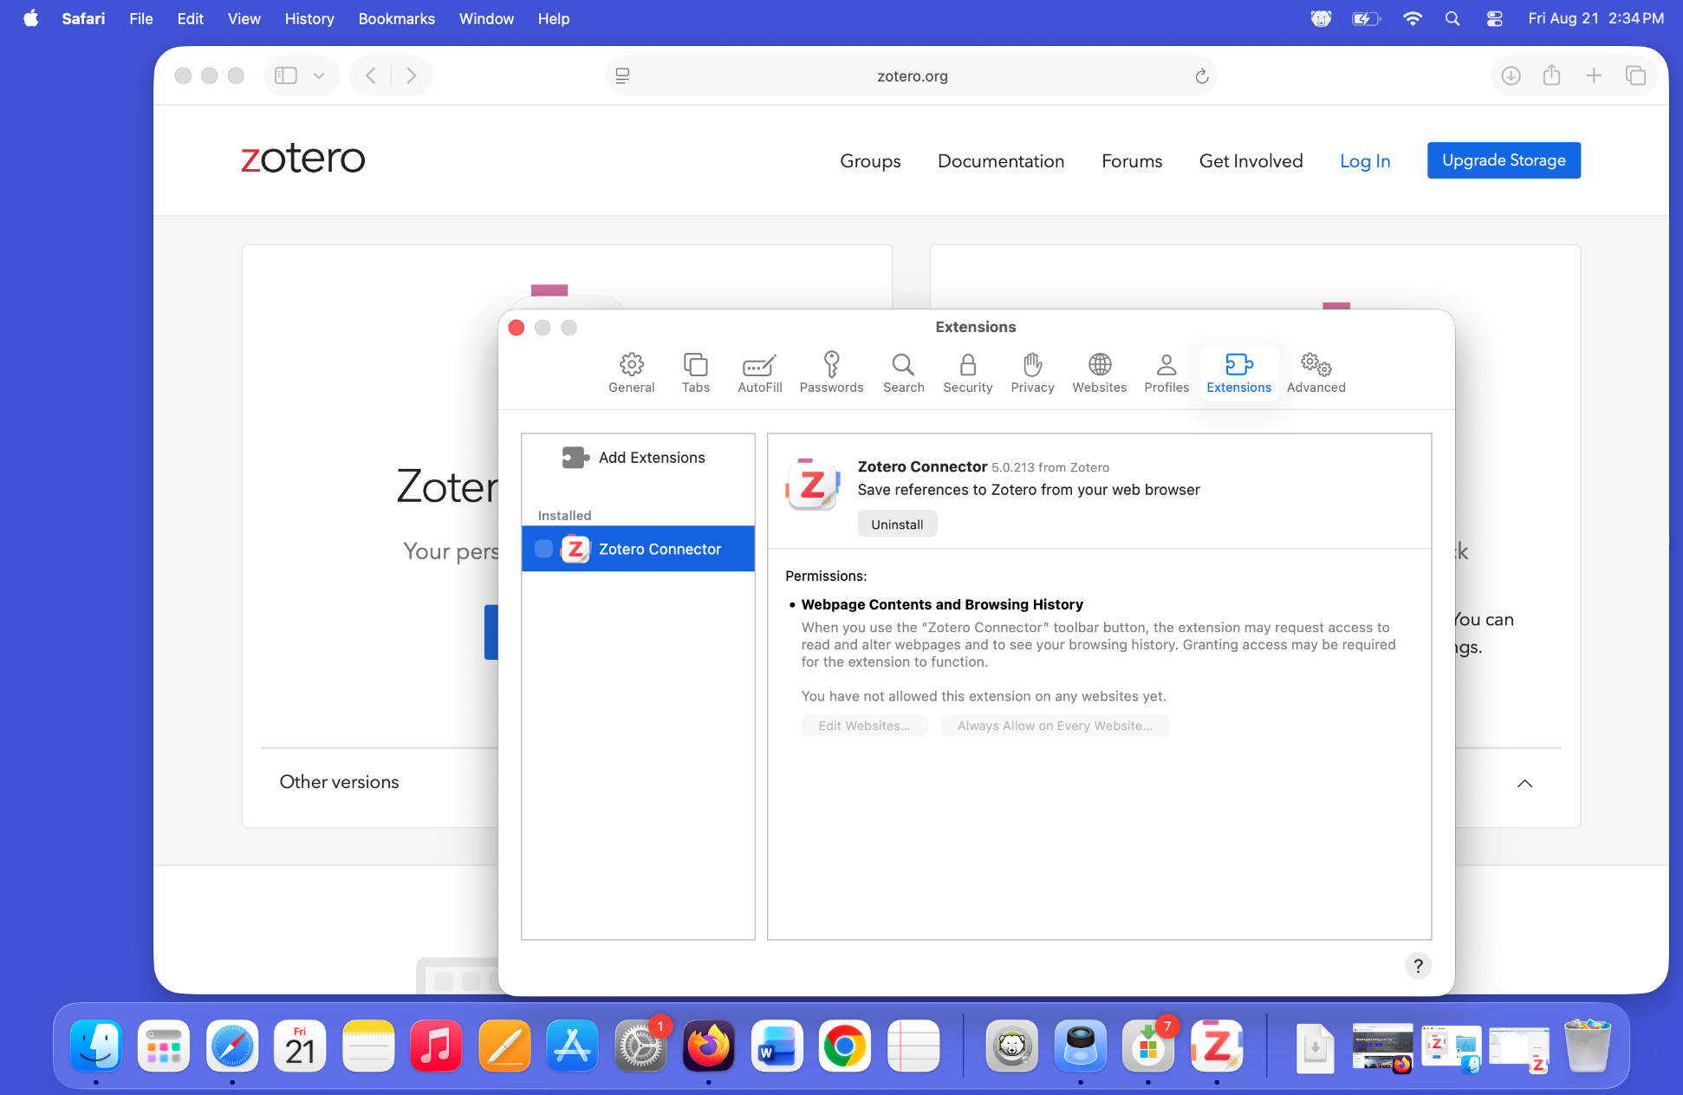
Notes:
Click on the Zotero Connector entry to read what the extension can do.

Slide 12
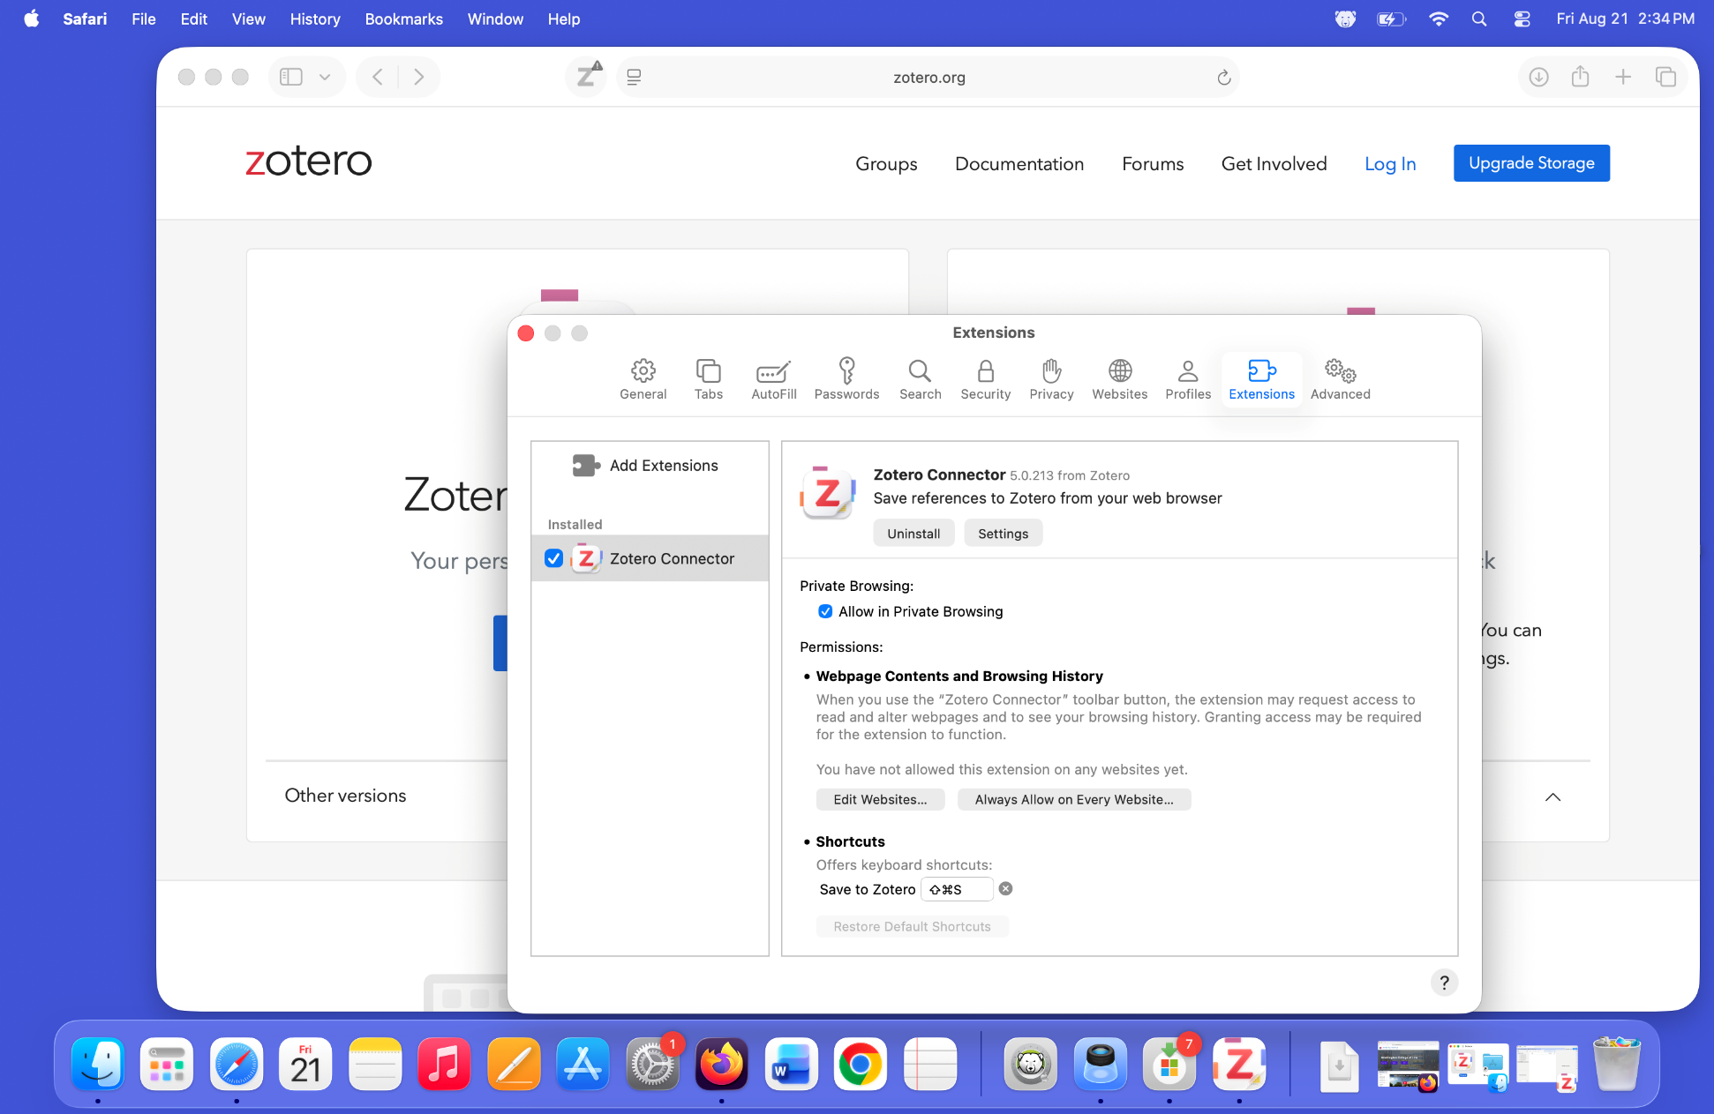
Notes:
Check the check box next to it in the listing under Installed extensions to enable the connector.

Slide 13
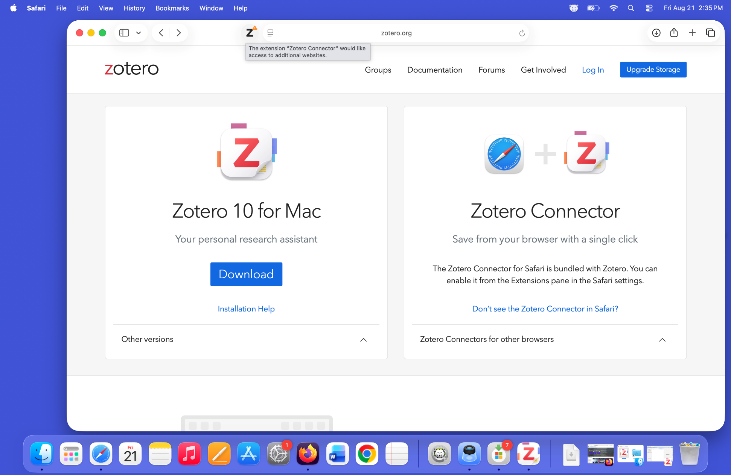
Notes:
The Zotero icon appears in the toolbar, with a notice attached letting you know that the connector needs additional access permissions.
Click on the message.

Slide 14
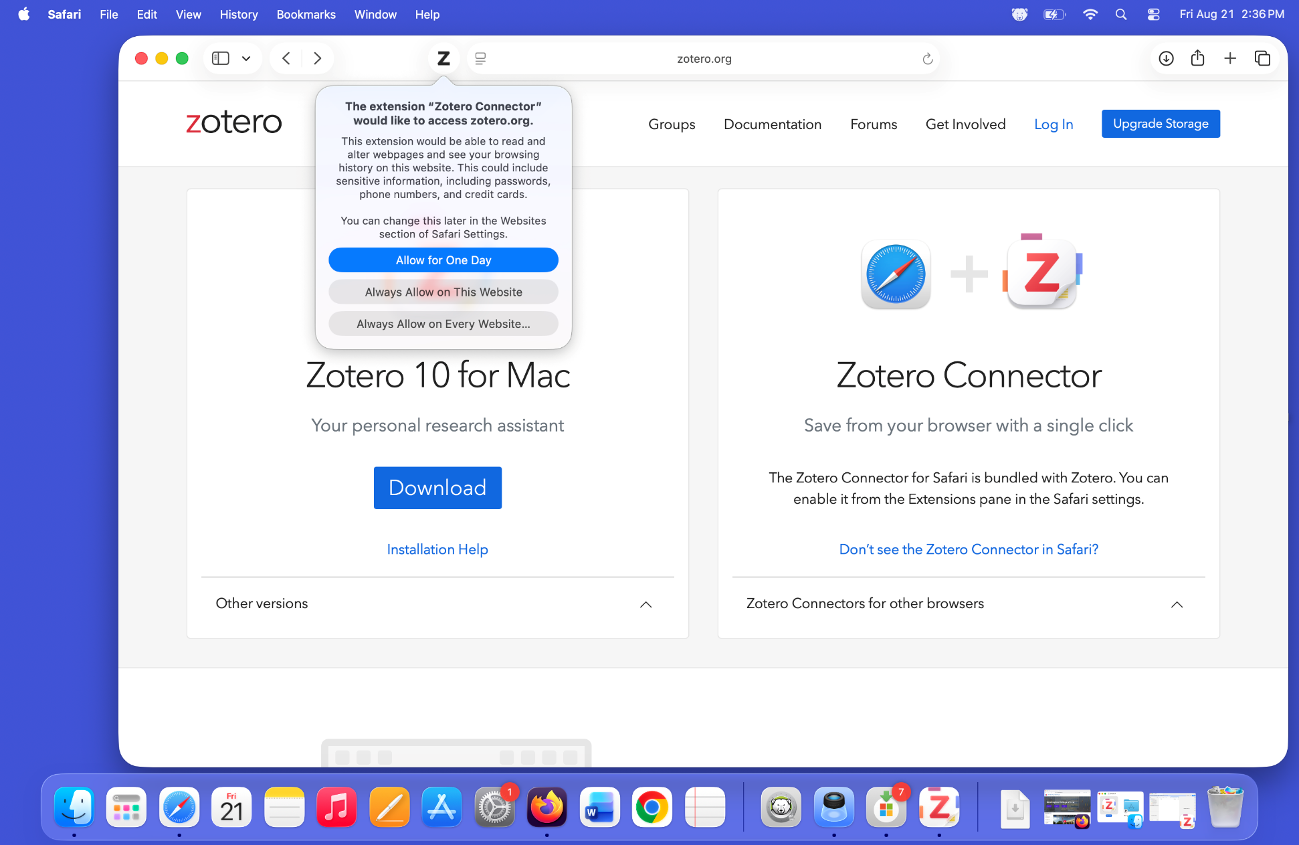
Notes:
A dialog box opens that asks you for permission to access zotero.org, and giving you several options.
Click on the most extensive: the “Always Allow for Every Website…” Zotero needs this to function.

Slide 15
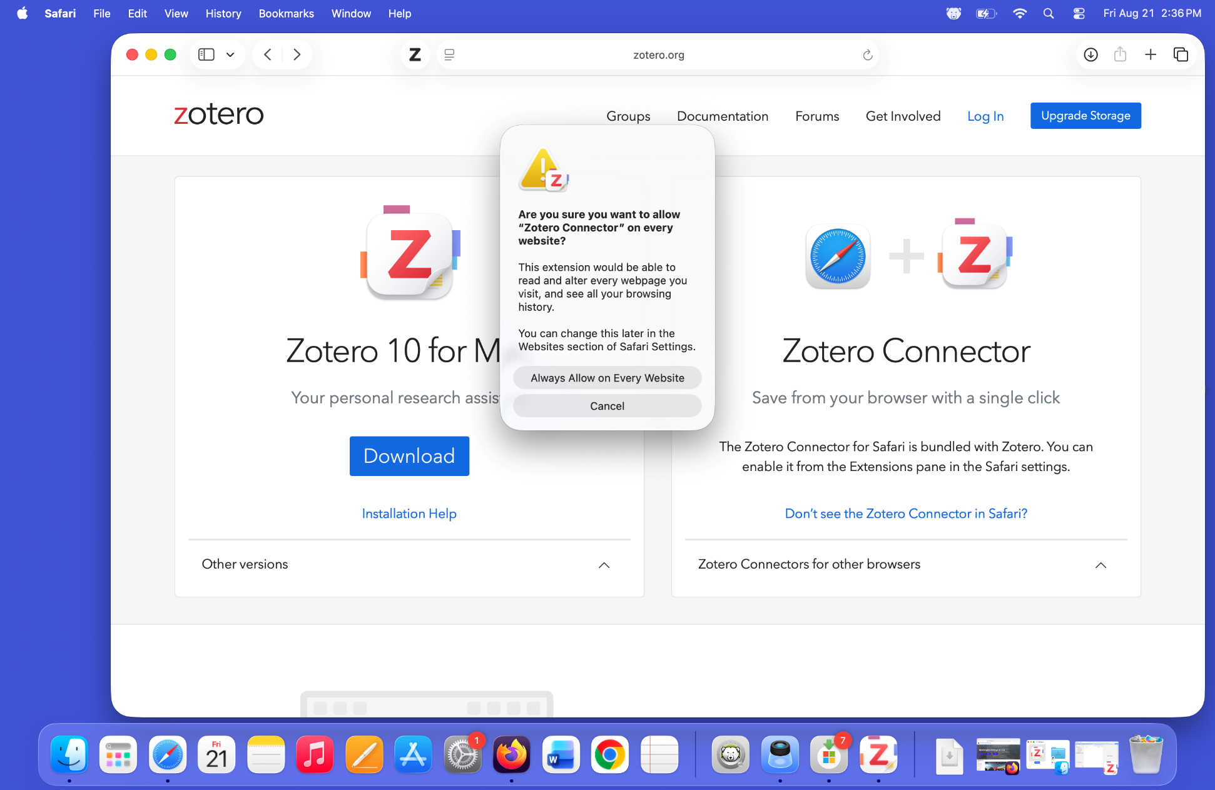
Notes:
They really want you to be sure, which is a good thing. Zotero can be trusted, so you should confirm by choosing “Always Allow on Every Website.”
Safari is now set up to work with Zotero.

Slide 16
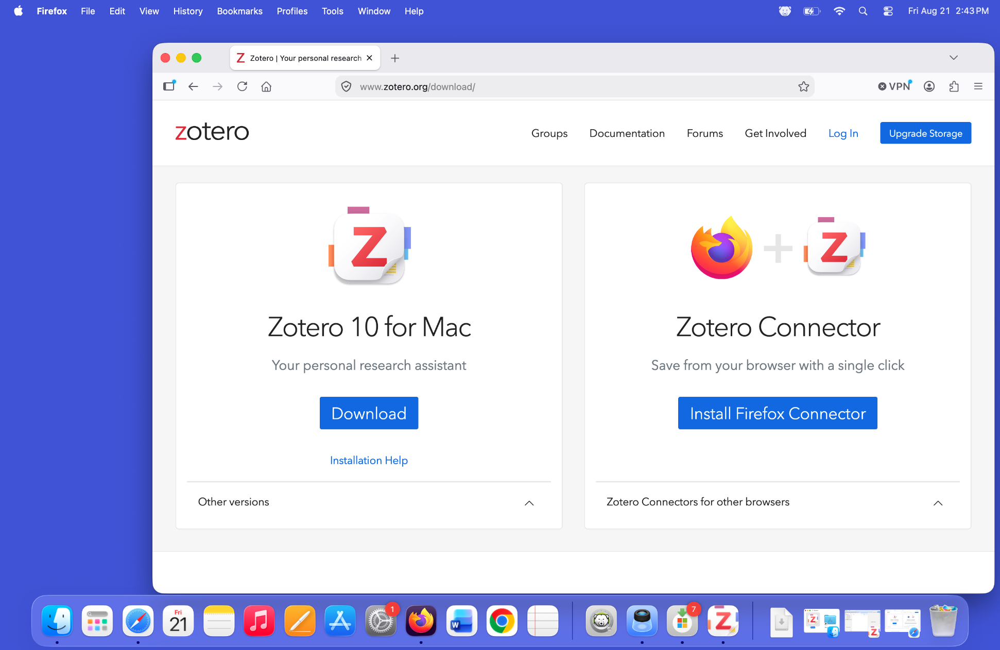
Notes:
You might want a different browser. Here is how to install the connector for Firefox.
Use Firefox to open the download page.
It has sensed that you are using Firefox, and it offers you the “Install Firefox Connector” button.
Click on that blue button.

Slide 17
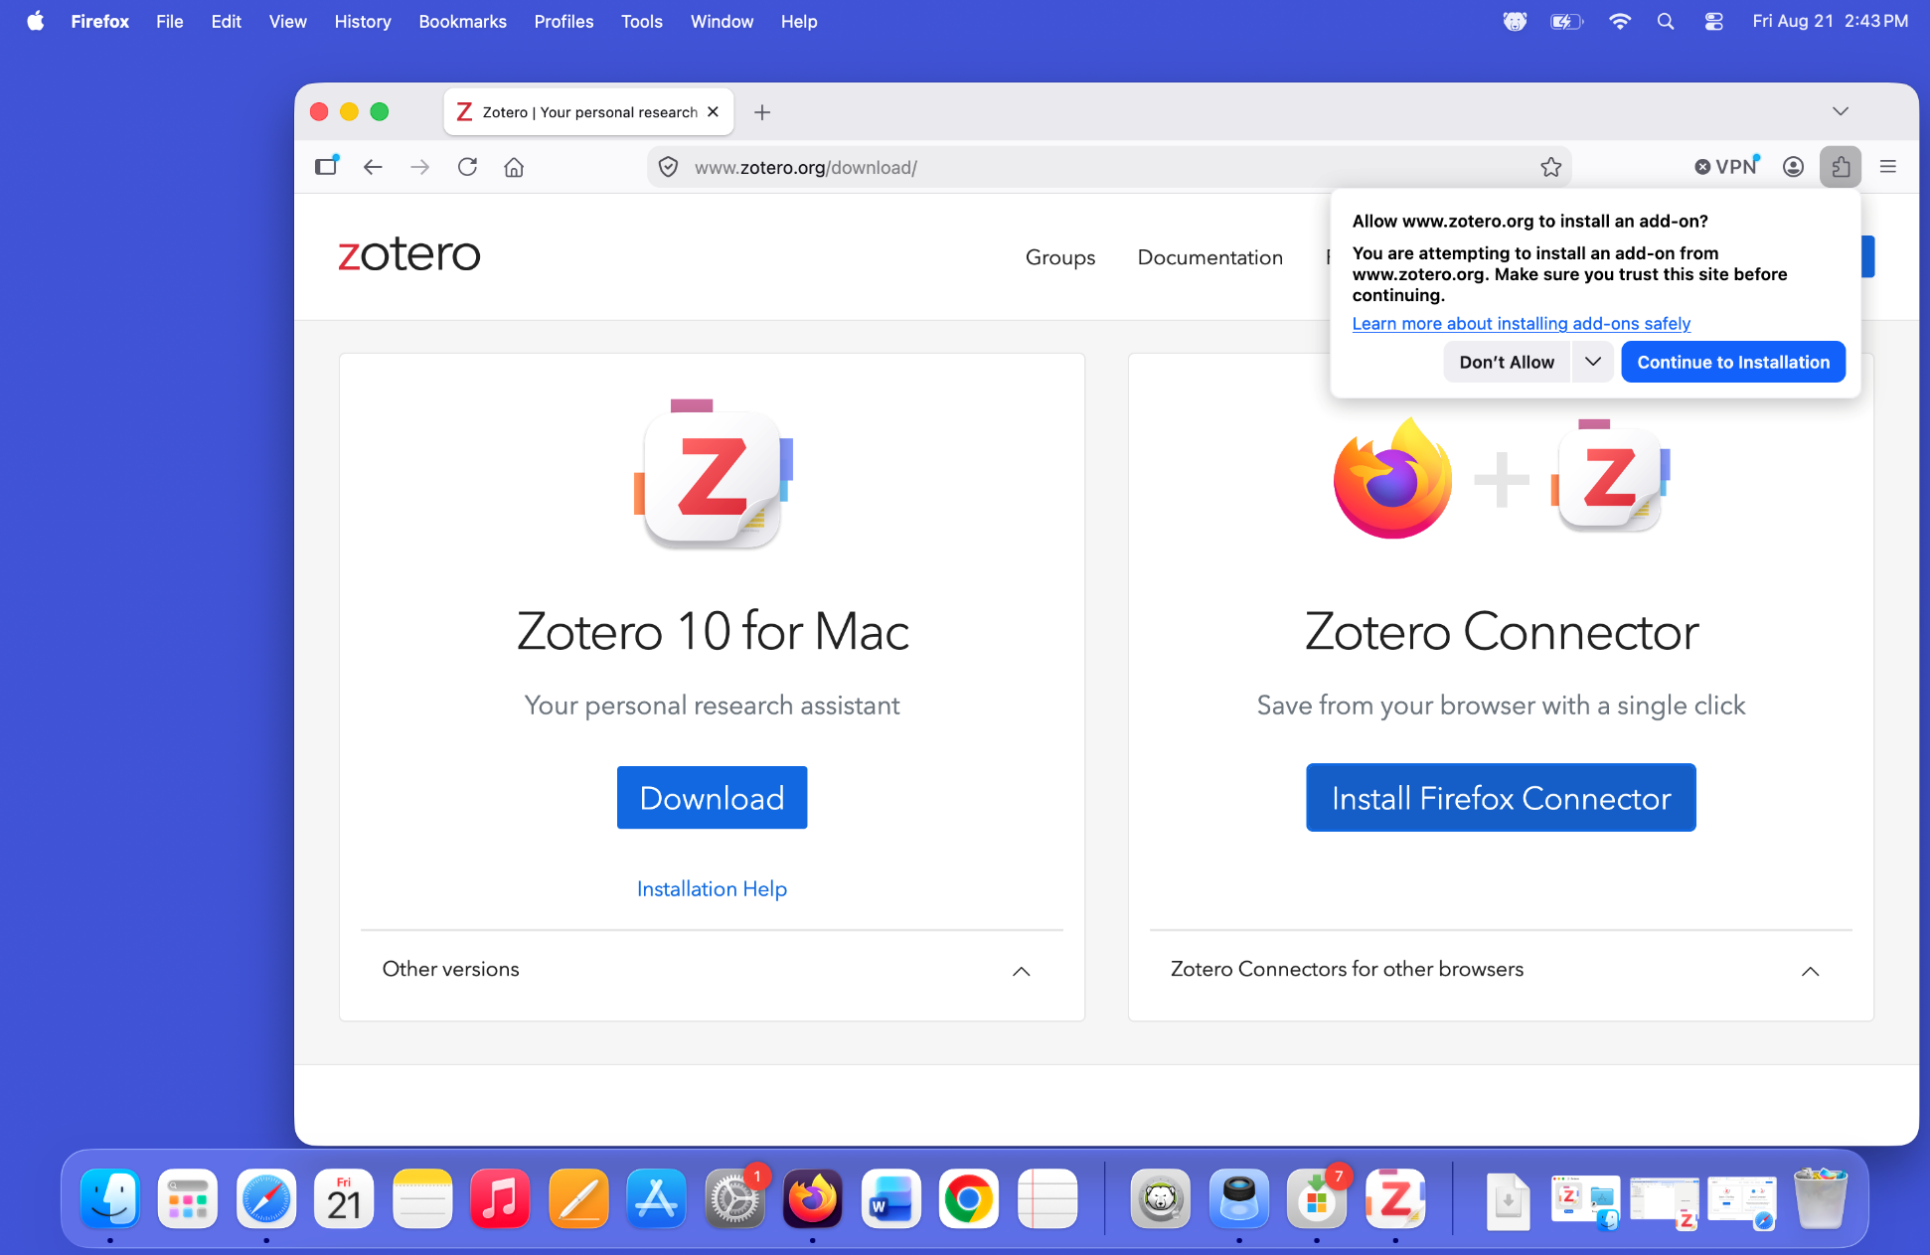
Notes:
Firefox asks you if you are sure you want to install an add-on from zotero.org. You do.
Click on the blue “Continue to installation” button.

Slide 18
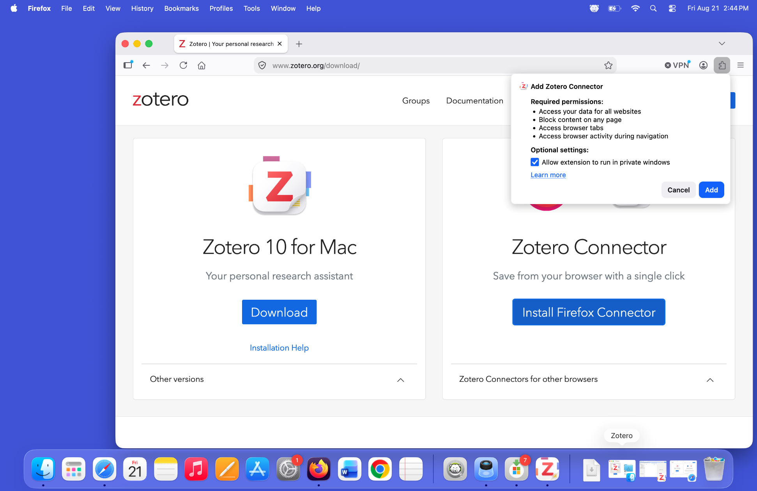
Notes:
The installation permissions warning dialog box will appear, listing what the add-on will be able to do, and offering you the option to allow it in private windows (your choice).
Click on the blue “Add” button.
A “Z” Zotero button will appear in the toolbar.

Slide 19
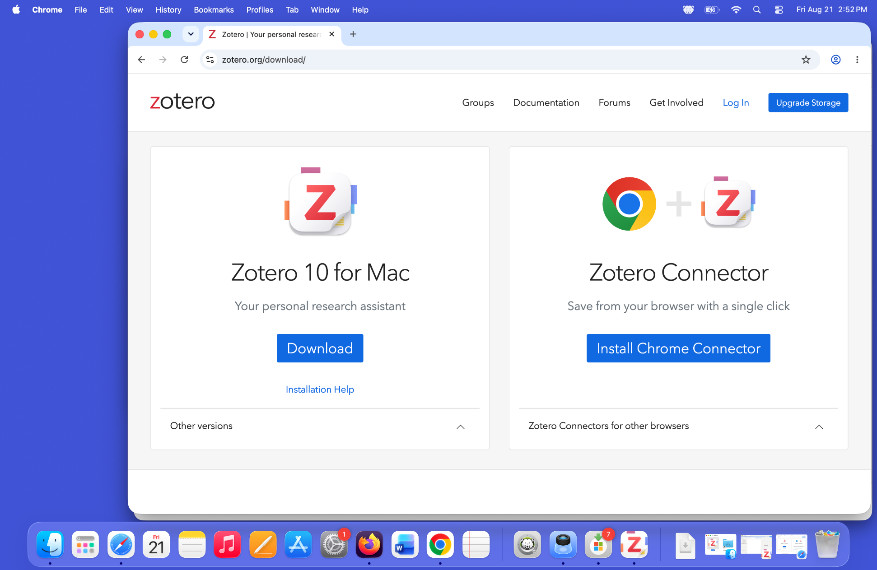
Notes:
You can install it in Google Chrome or any of the other chromium-based web browsers as well.
Use the chromium-based browser to open the Zotero download page
Click on the blue “Install Chrome Connector” button.

Slide 20
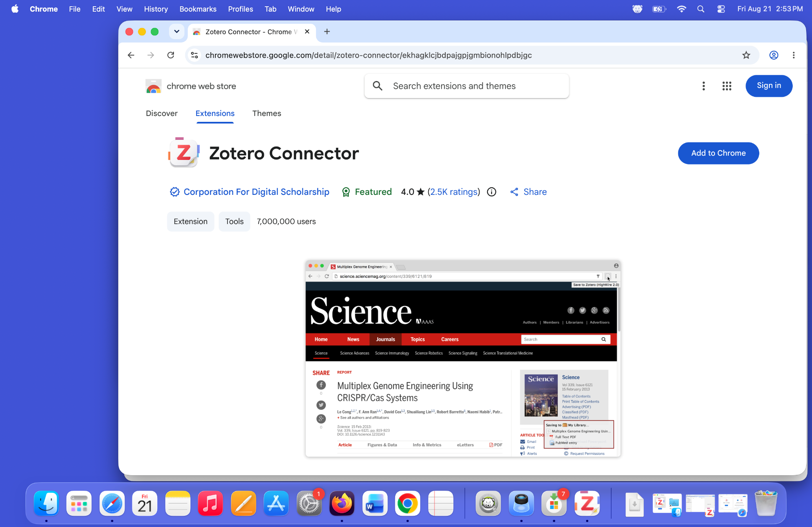
Notes:
It will take you to the Chrome web store.
Click on the blue “Add to Chrome” button.

Slide 21
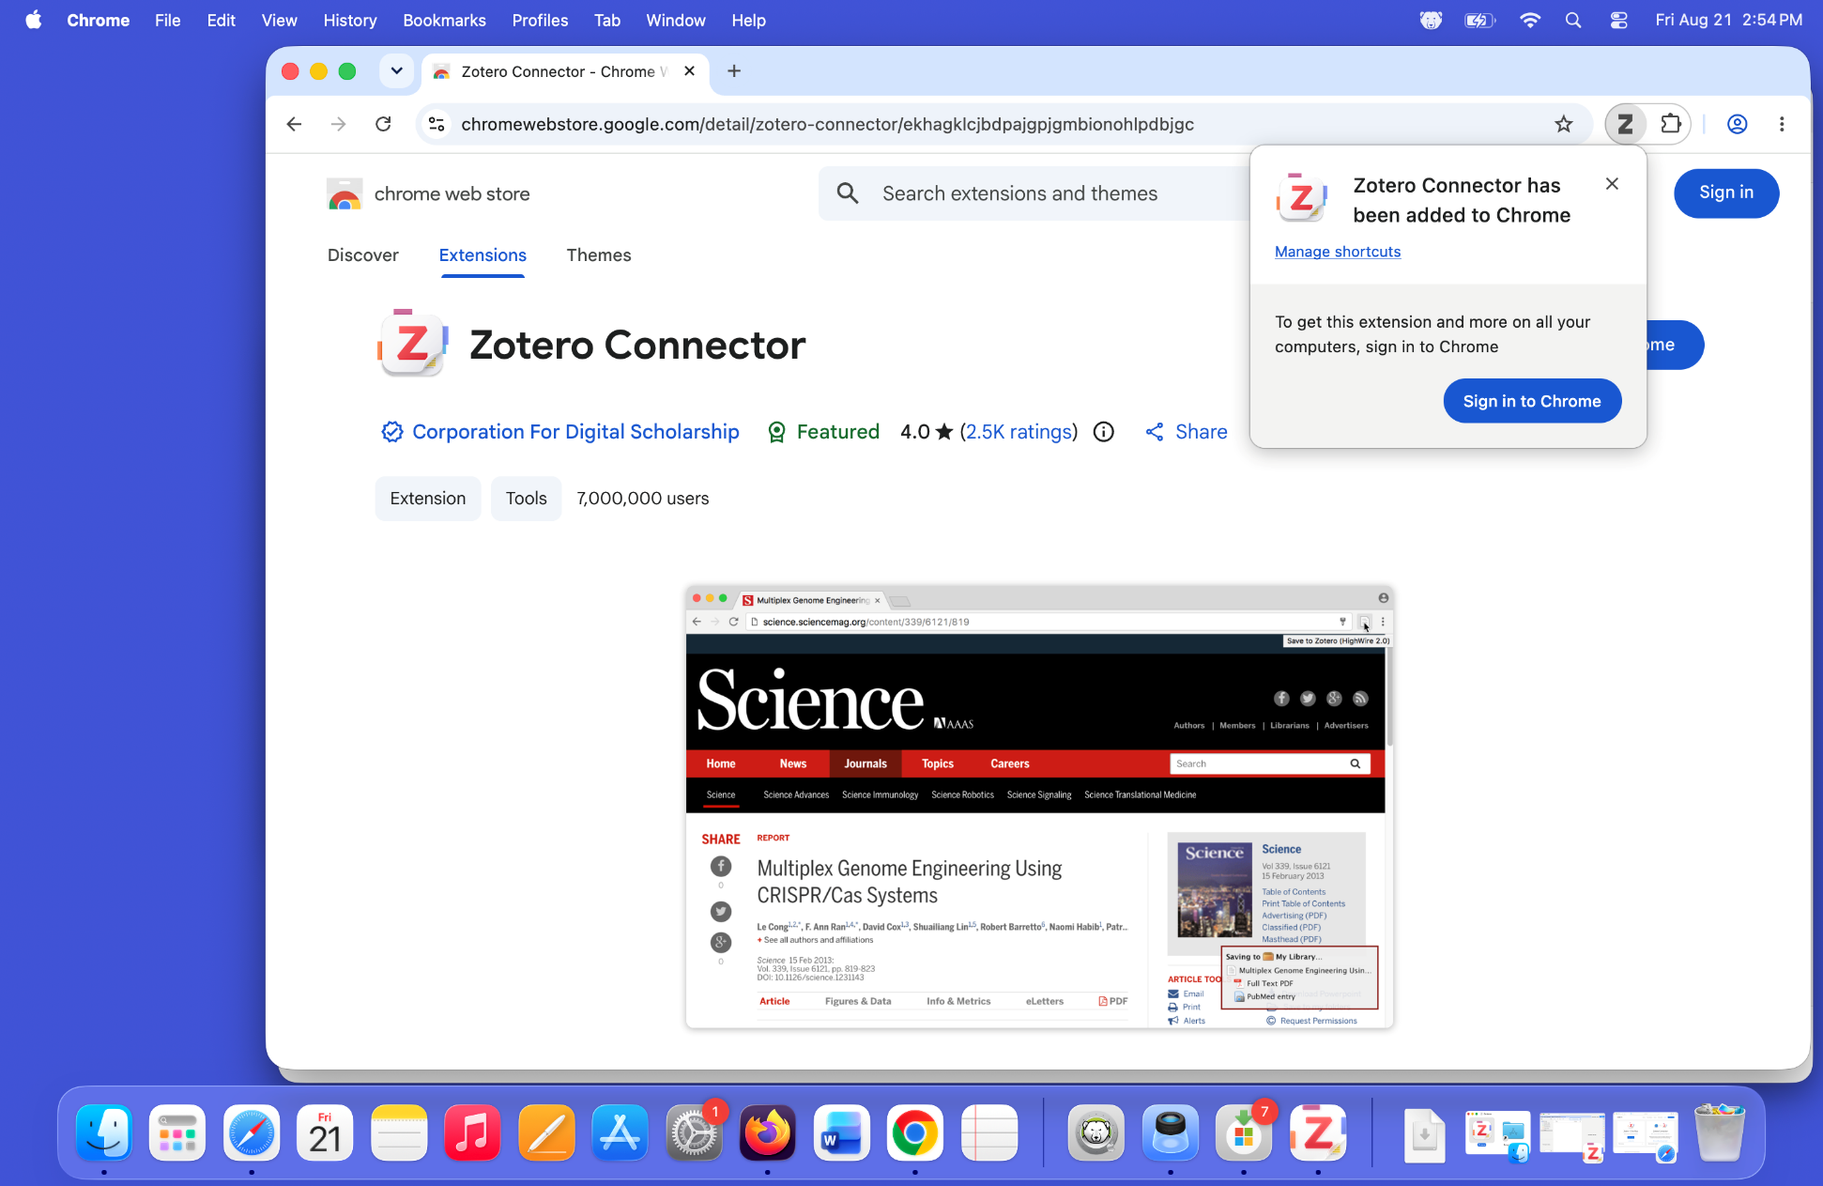
Notes:
- A dialog box will tell you that it has been installed.

Slide 22
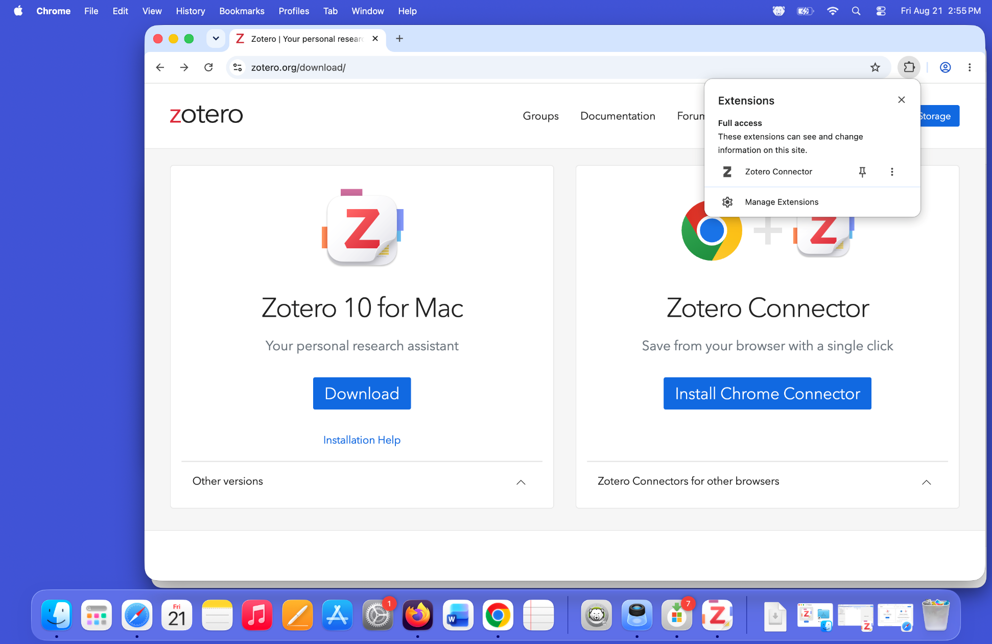
Notes:
To get the Zotero icon to always appear in the toolbar, click on the extensions icon (looks like a jigsaw puzzle piece).
Next to the listing for the Zotero connector is a push-pin icon. Click on it to pin the Zotero icon to the toolbar.

Slide 23
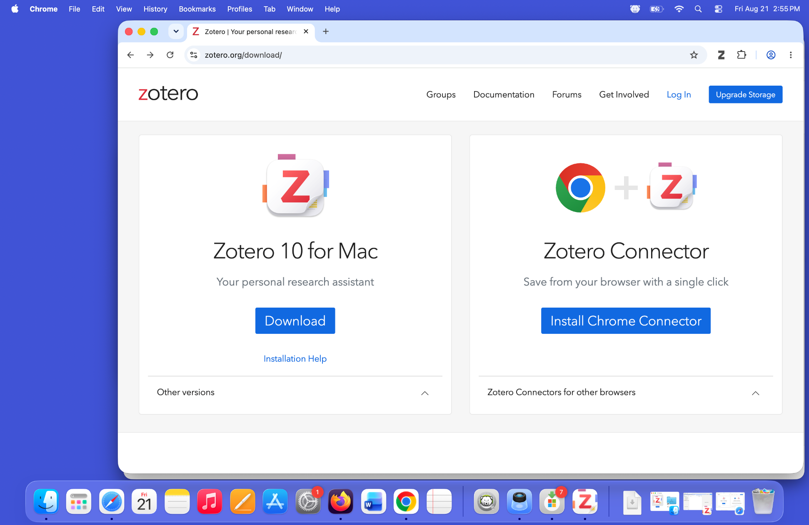
Notes:
- Ta-Da! Your browser is now set up.

