Slide 1
installing Zotero on Windows

Slide 2
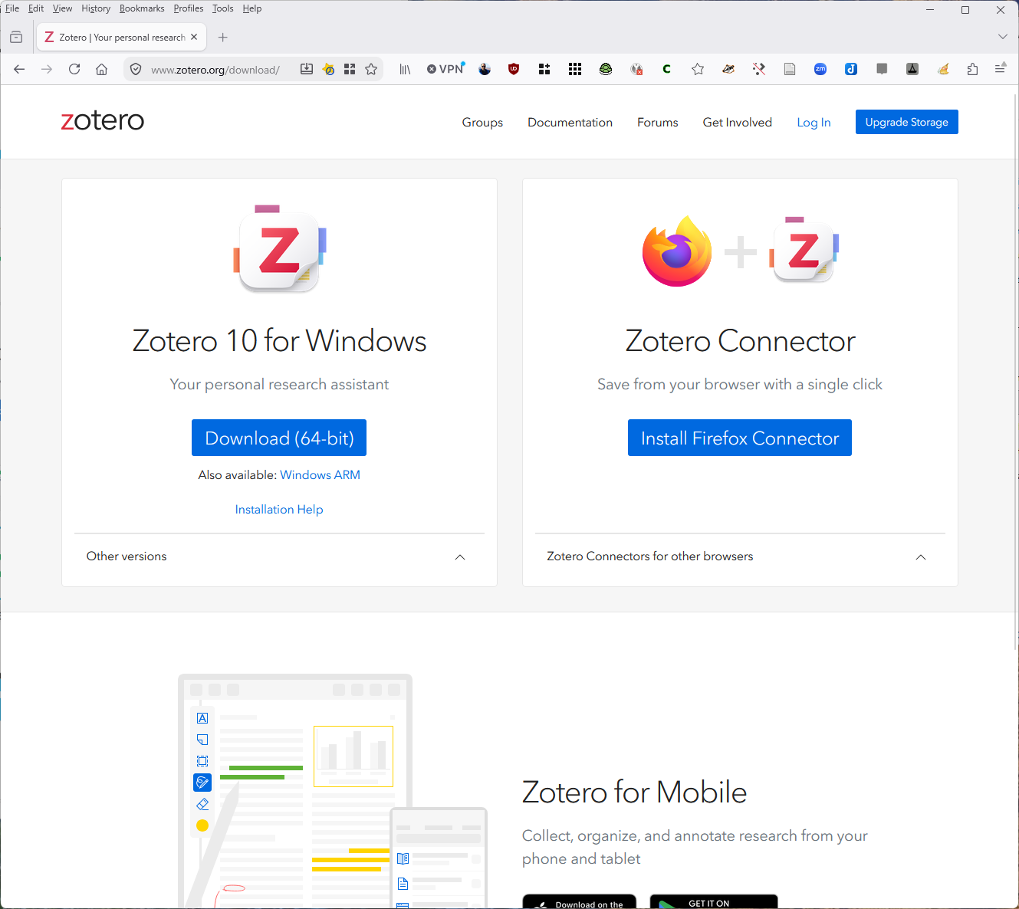
www.zotero.org/download
Notes:
From the download page, https://www.zotero.org.download. I automatically senses which operating system you are using and which web browser, and it then gives you the appropriate links.
Click on the blue “Download (64-bit)” button under Zotero 10 for Windows.

Slide 3
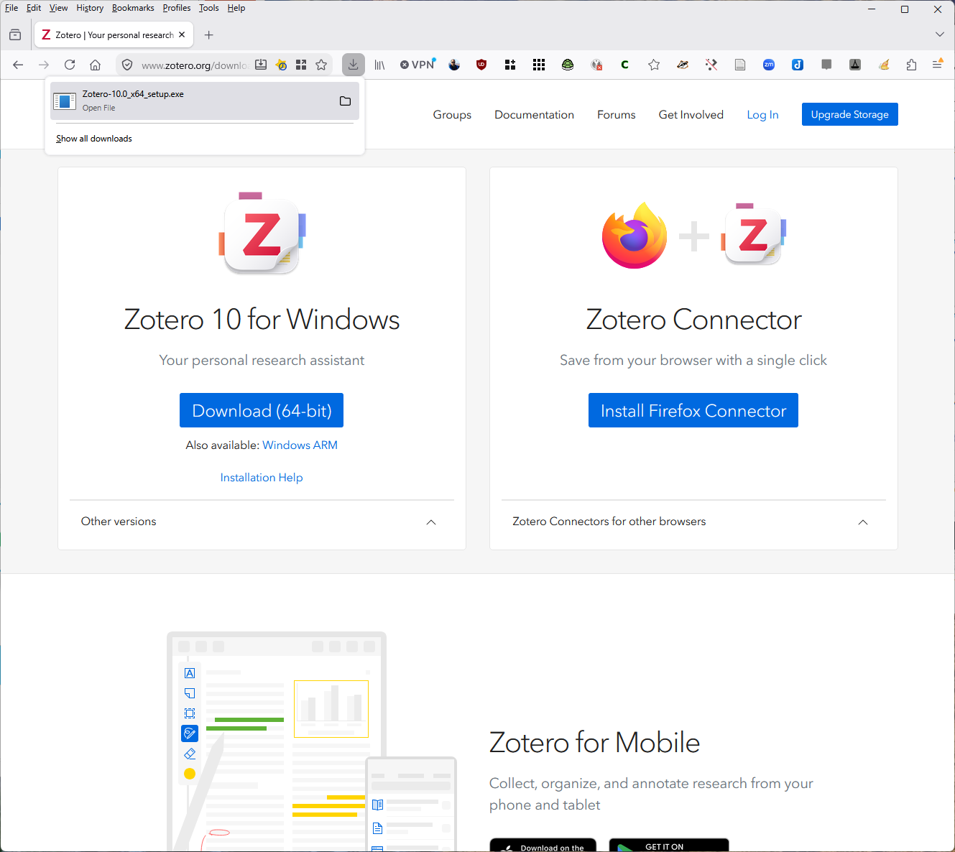
Notes:
The download pop-up dialog box appears and shows you the download.
Open the download by clicking on it.

Slide 4
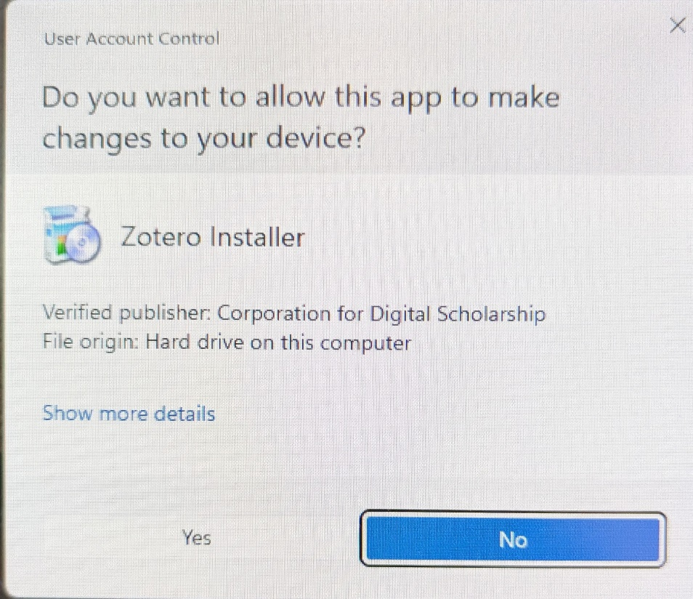
Notes:
- Windows will pop-up a dialog box asking if you want to let the Zotero installer to make changes to your device. Click on the “Yes” button.

Slide 5
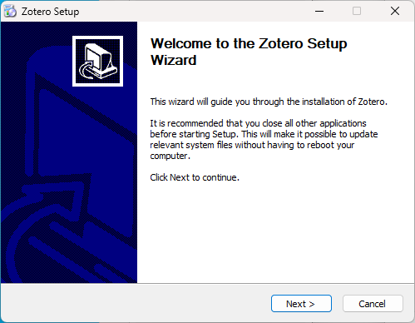
Notes:
- The Zotero Installer pops up a dialog box. Click on the “Next” button to begin the setup process.

Slide 6
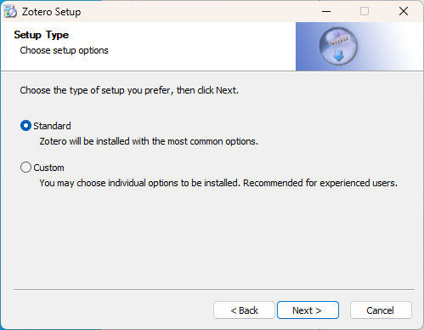
Notes:
Choose the standard install option, and click the “Next” button to continue.

Slide 7
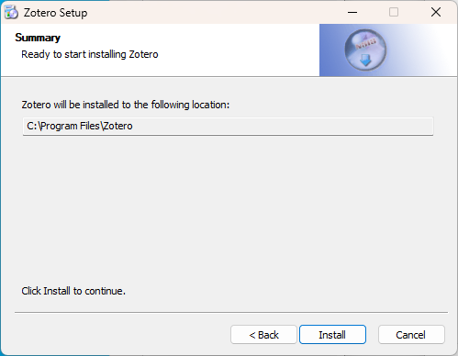
Notes:
- The installer indicates where it will install the program files, and this is probably correct for everyone (If not, just change it to your preferred location). Click on the “Install” button to start the installation.

Slide 8
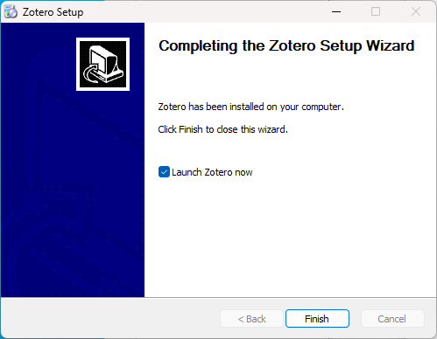
Notes:
- When it’s done, it will ask you if you want to start Zotero now. If so, check the “Launch Zotero now.” box and the click on the “Finish” button.

Slide 9
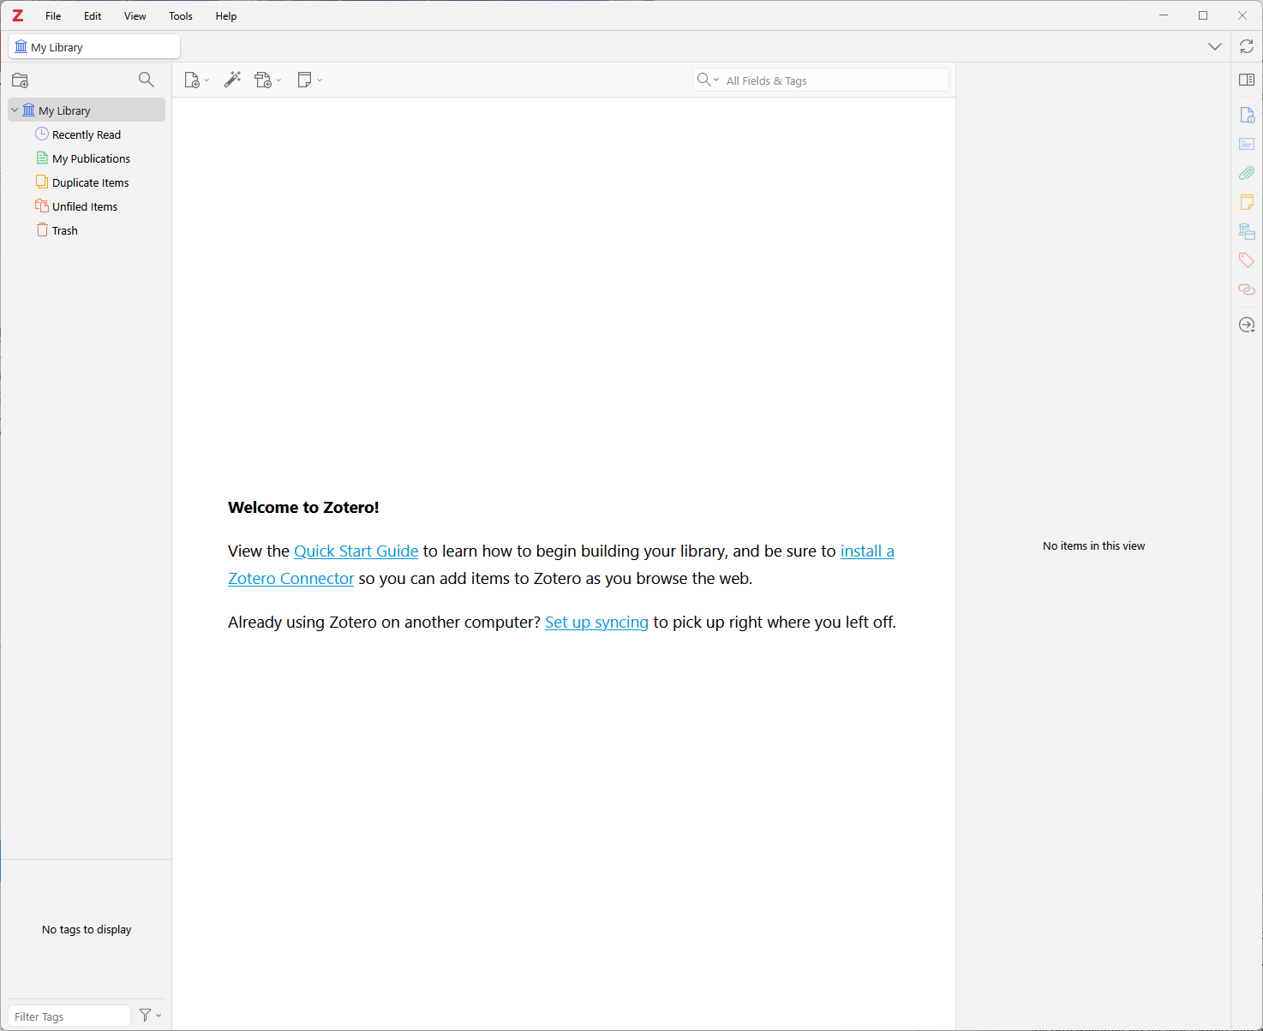
Notes:
- This is zotero as it is first installed on your computer. Now let’s move on to installing connector(s) in your web browser(s).

Slide 10
Notes:
- We’ll start with Firefox. On the download page, click on the blue “Install Firefox Connector” button.

Slide 11
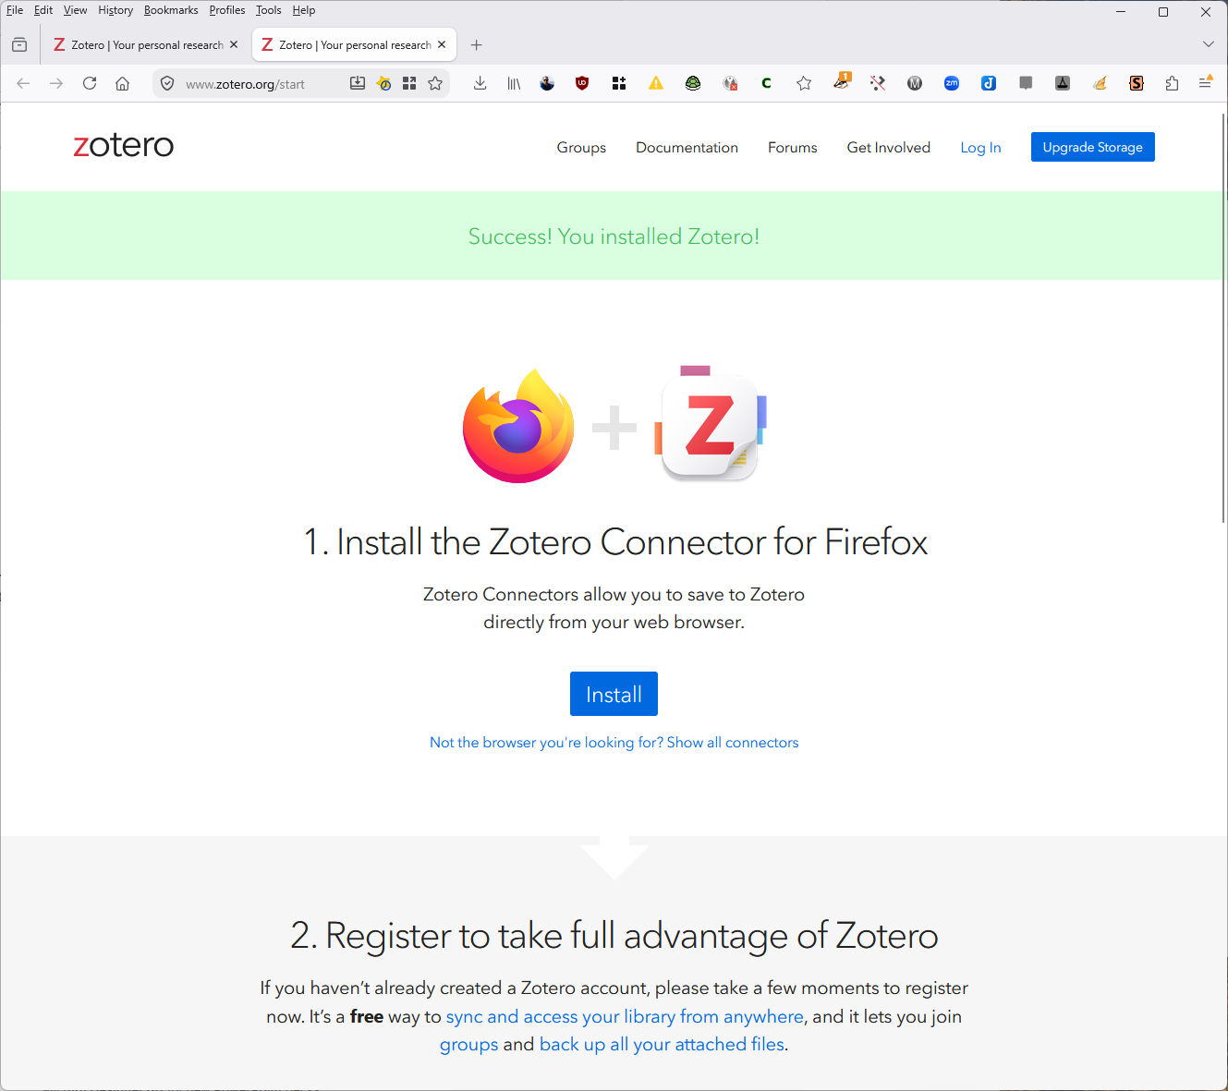
Notes:
- This will bring you to the connector installation page. Click on the “Install” button.

Slide 12
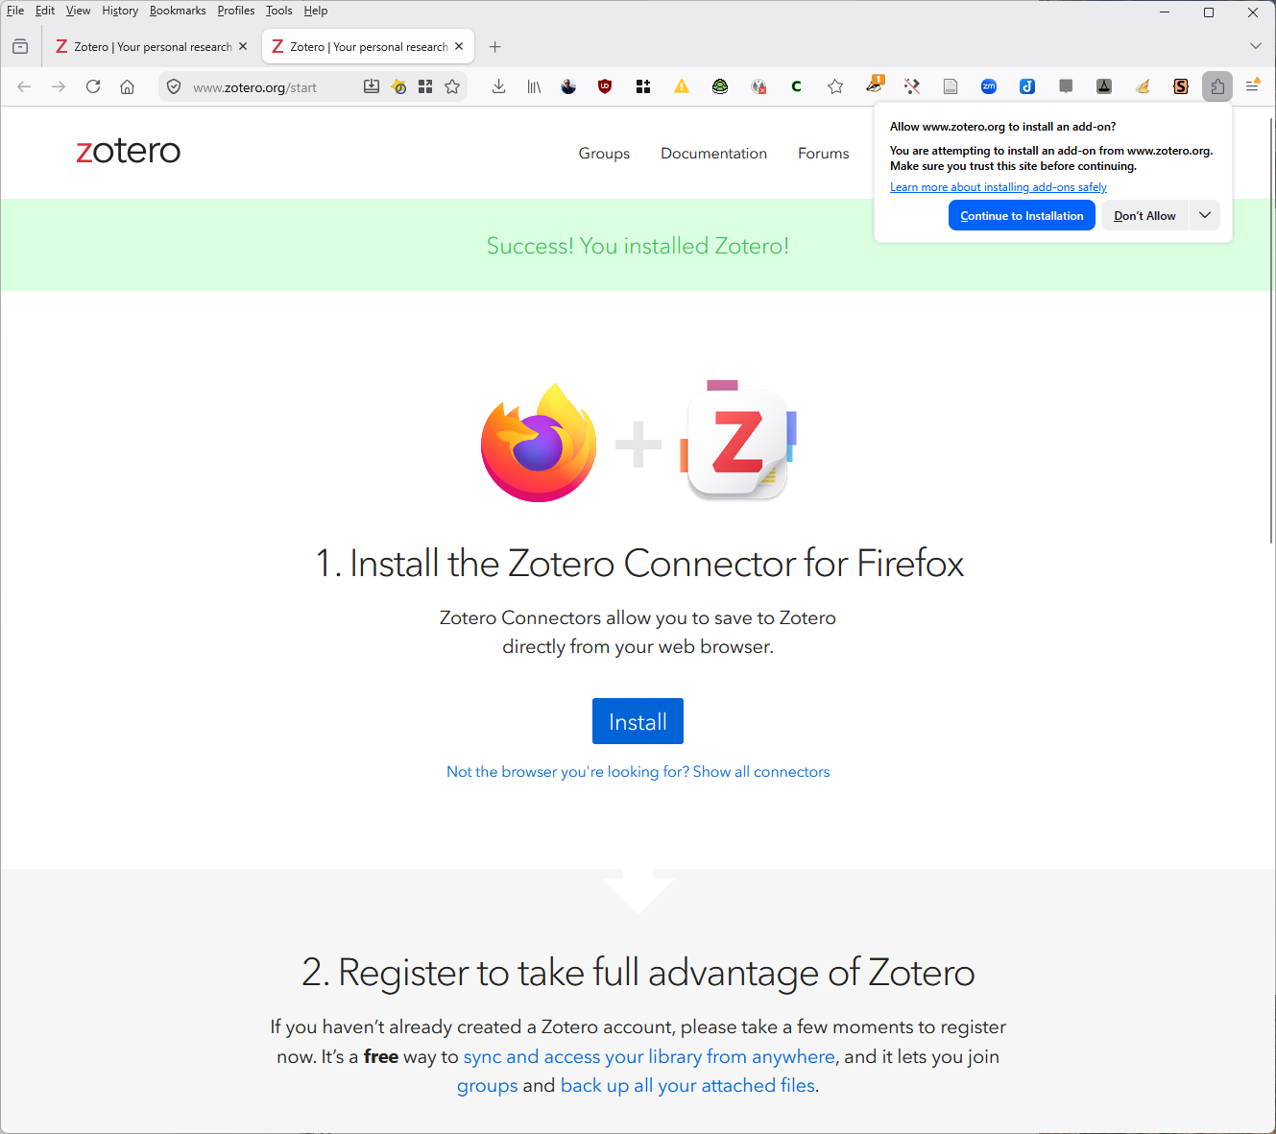
Notes:
- A warning will pop-up in the upper-right of your browser asking if you to allow zotero.org to install an add-on to the browser. You do, so click the blue “Continue to Installation” button.

Slide 13
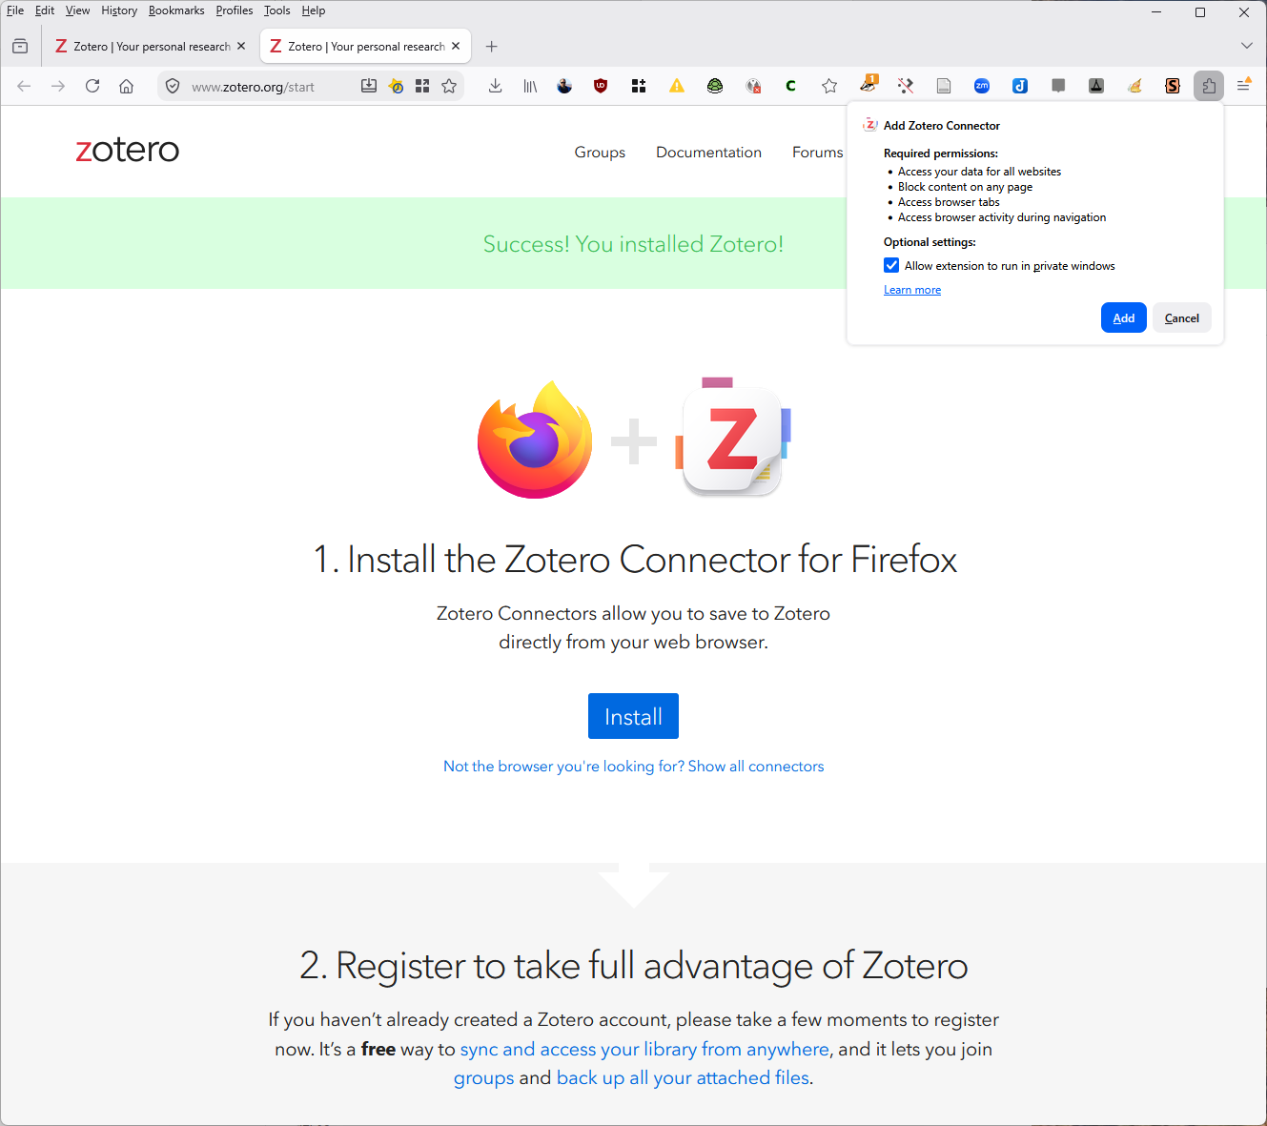
Notes:
- Another warning dialog will pop-up in the upper-right, this time listing what the add-on will be able to do, and allowing you to decide whether you want to allow it to run in private windows (I have never run zotero in a private window, but I don’t see the harm in allowing it). Click on the blue “Add” button.

Slide 14
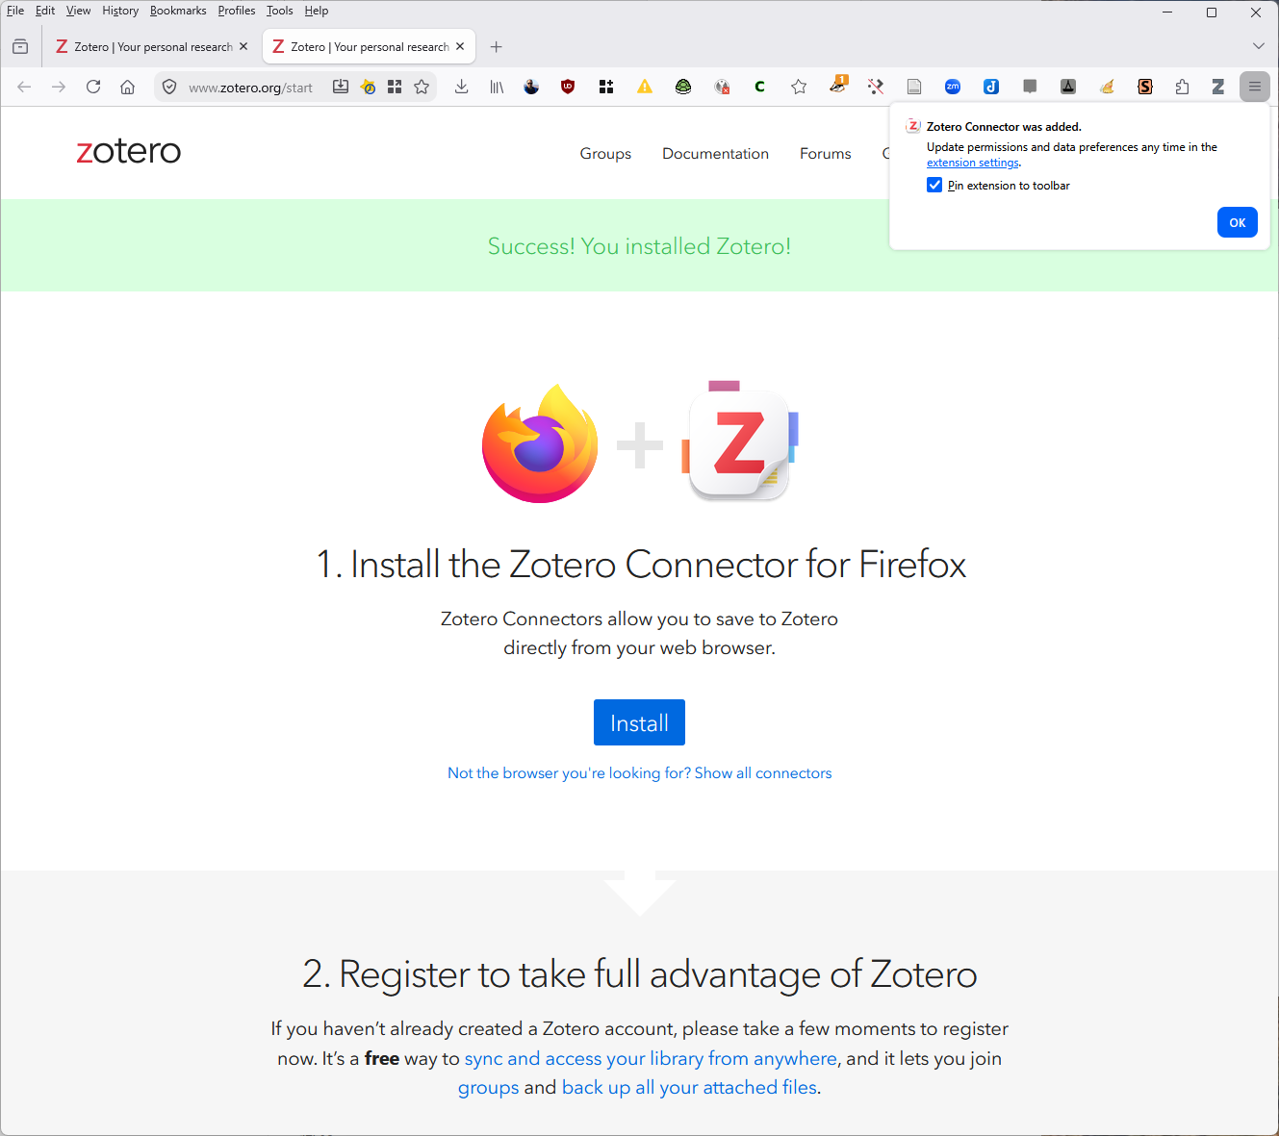
Notes:
-In the next pop-up, you do want to pin the extension icon to the toolbar, so check that box, and then click on the blue “OK” button.

Slide 15
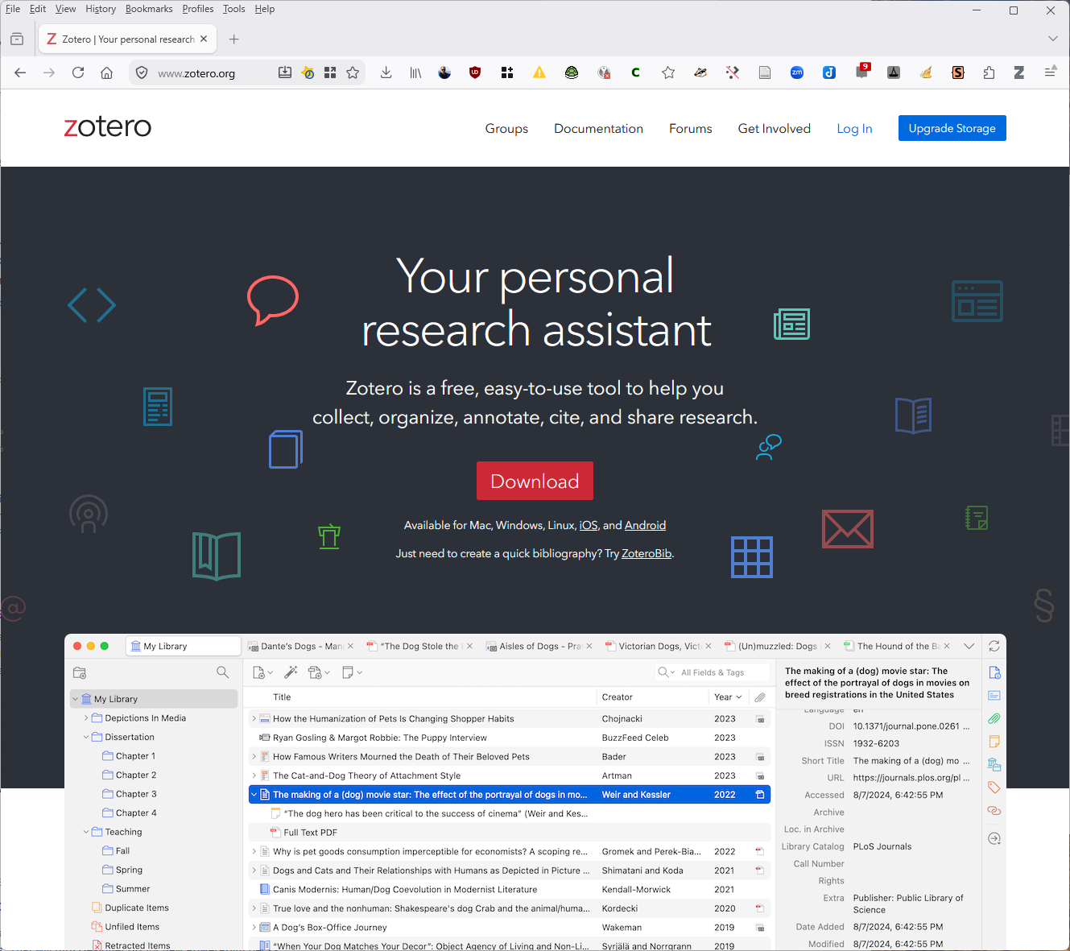
Notes:
- Notice the Zotero “Z” icon in the toolbar. This will change depending on what is on the open webpage. It stays a “Z” until Zotero is running on the computer. Then it changes to be an icon for whatever source type is being displayed in the web browser: webpage, book, article, book chapter, manuscript, video, audio, etc.

Slide 16
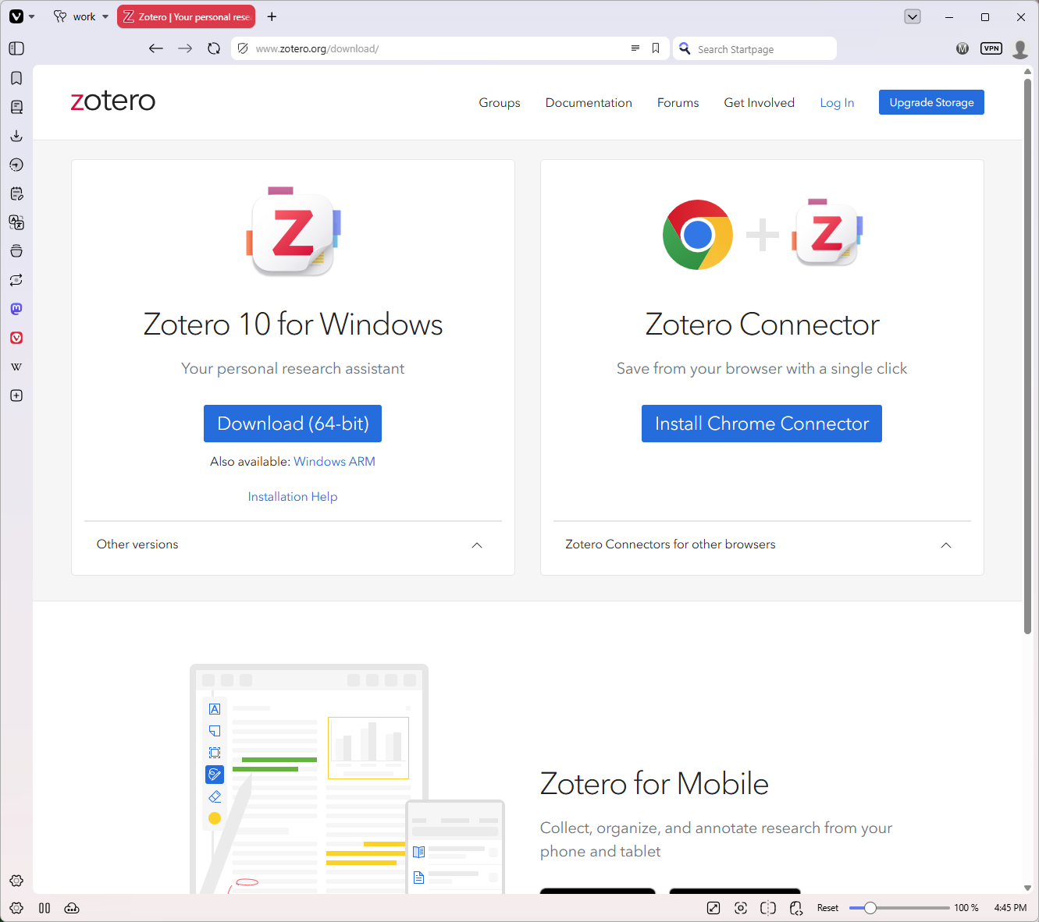
Notes:
Now let’s add a connector to a Google Chromium-based browser. I’m using Vivaldi instead of Chrome, because Chrome (which is bundled with all of Google’s web services) is a privacy nightmare now. I do not recommend Google Chrome at all.
Chromium is the open source base code that Google Chrome uses, but without any proprietary additions. It is also the base for Microsoft Edge, Vivaldi, Opera, Brave, Samsung Browser, and ungoogled-Chromium. These can each add their own proprietary additions and web services to their versions.
Vivaldi is fairly good from a privacy and AI standpoint, as is Opera.
Click on the blue “Install Chrome Connector” button to start.

Slide 17
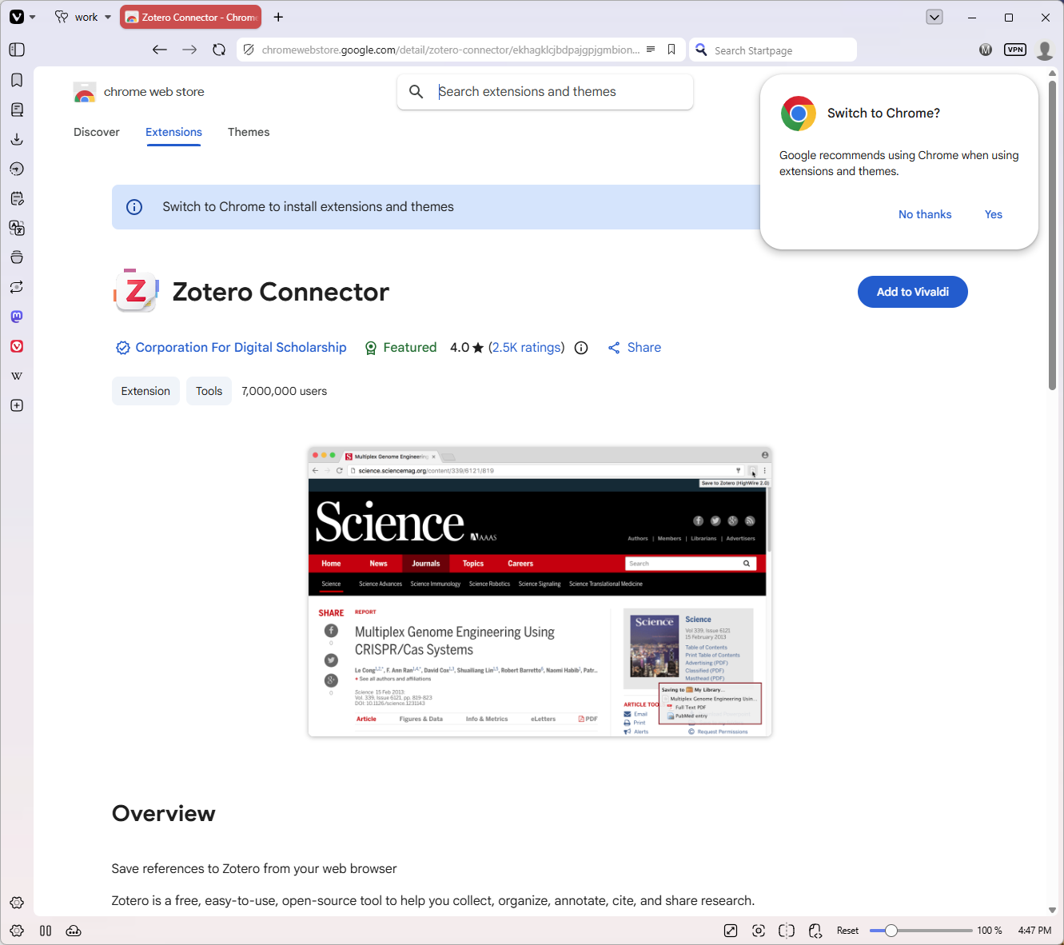
Notes:
It takes you to the Google Chrome web store, where all chromium add-ons must live.
It really wants you to use Google Chrome. You don’t need to, and I recommend that you do not. So click on the “No thanks” and then click on the blue “Add to Vivaldi” button.

Slide 18
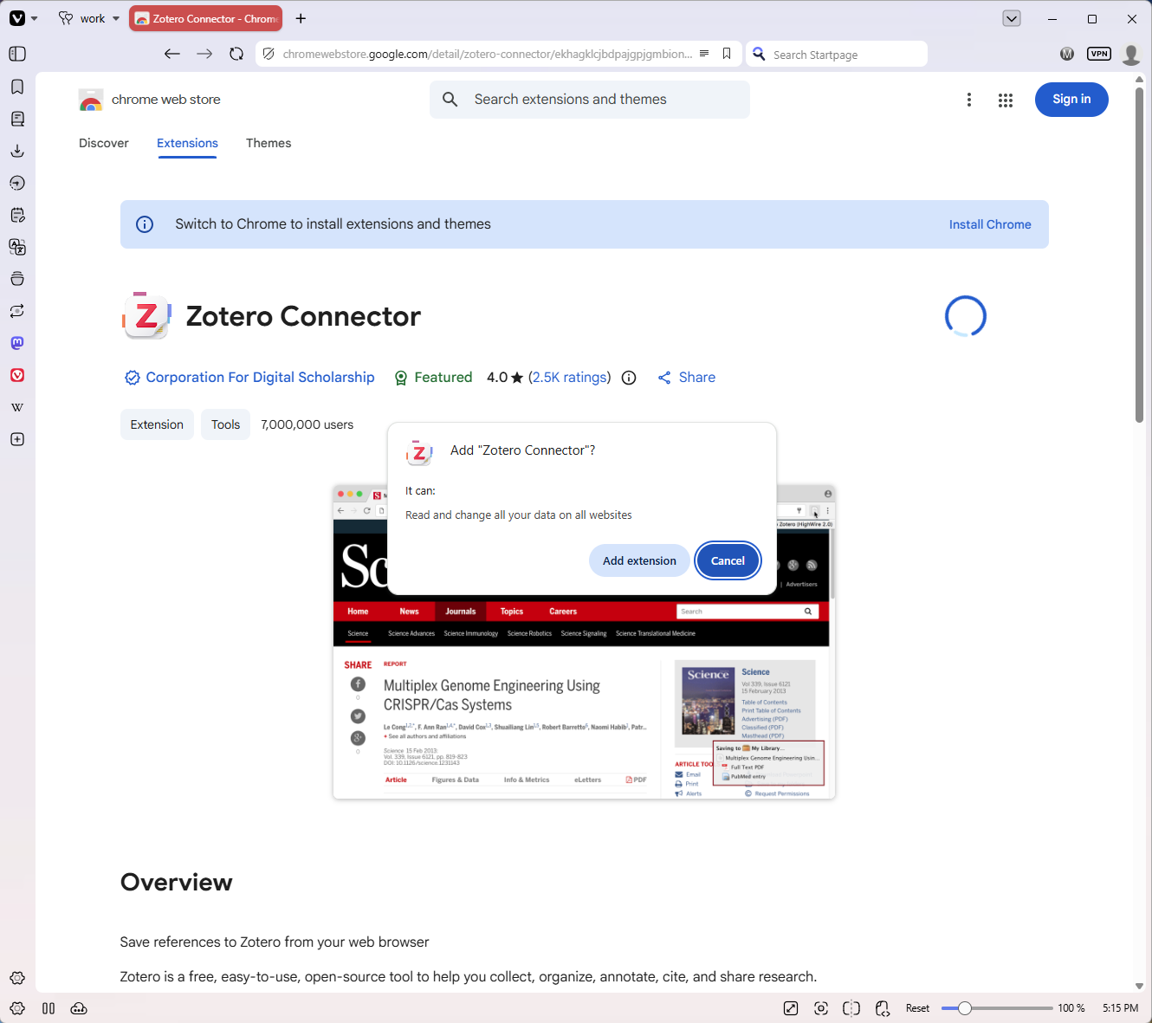
Notes:
A dialog box pops up that tells you what the add-on can do (it needs these permissions to do what it needs to do, and Zotero does not snoop on your data). See https://www.zotero.org/support/privacy
Click on the light blue “Add extension” button.

Slide 19
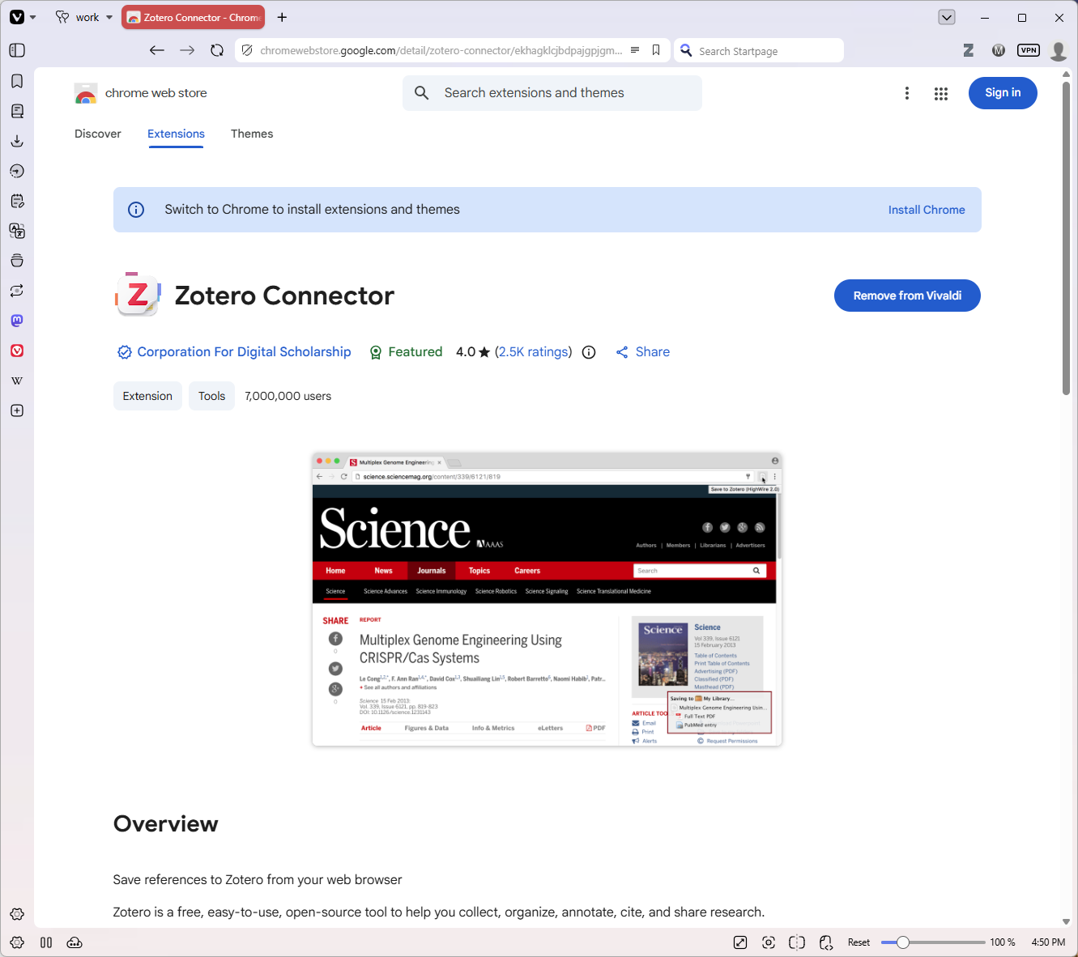
Notes:
- Note that the Zotero icon is now in your toolbar. On some chromium-based browsers, you may need to click on the add-ons button and then on a push-pin icon next to the Zotero Connector add-on in the listing in order for the icon to always appear.

Slide 20
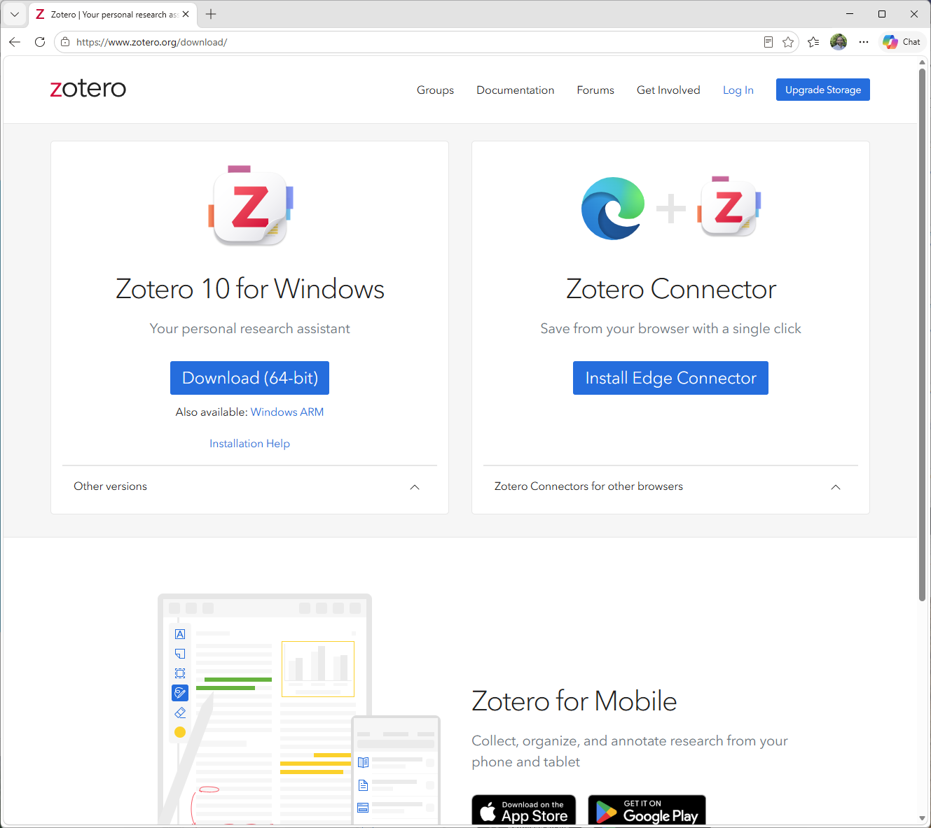
Notes:
Now let’s install it in another chromium-based browser, Microsoft Edge.
Similarly to other browsers, click on the blue “Install Edge Connector” button.

Slide 21
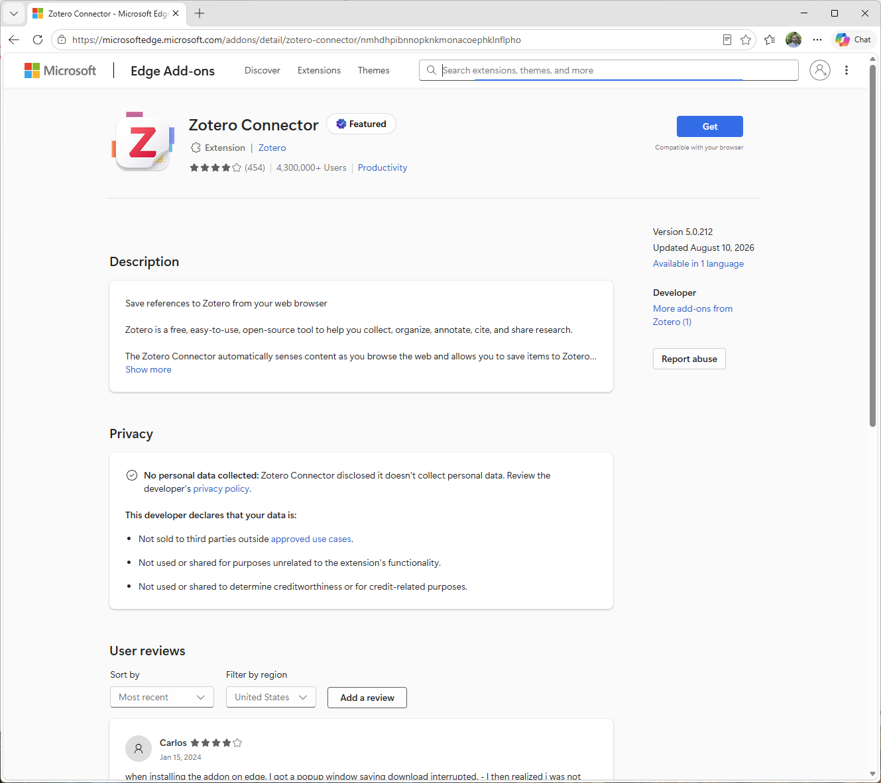
Notes:
Microsoft takes you to their own web store.
Click on the blue “Get” button.

Slide 22
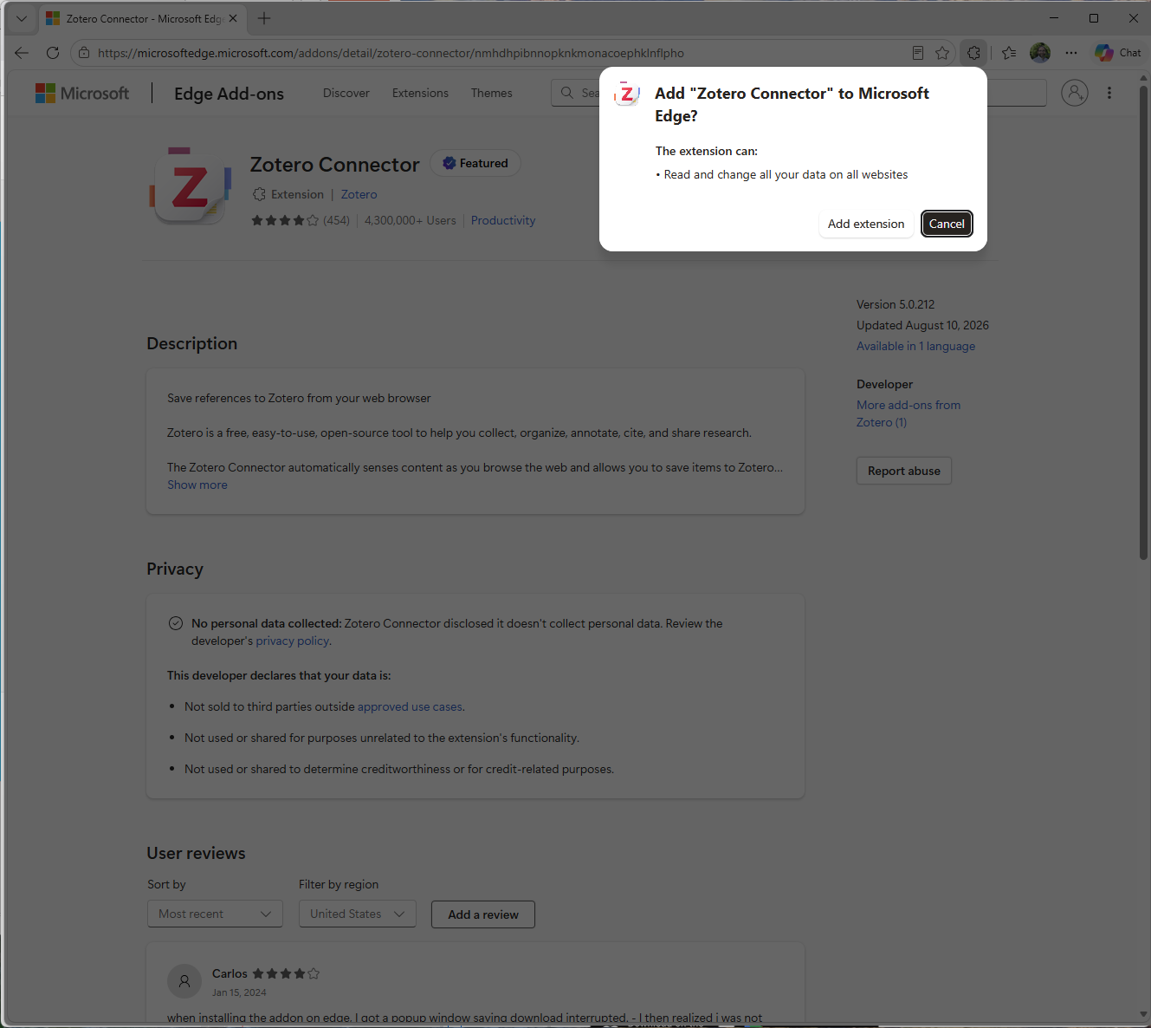
Notes:
- The warning box that tells you what the add-on can do will appear. Click on “Add extension”

Slide 23
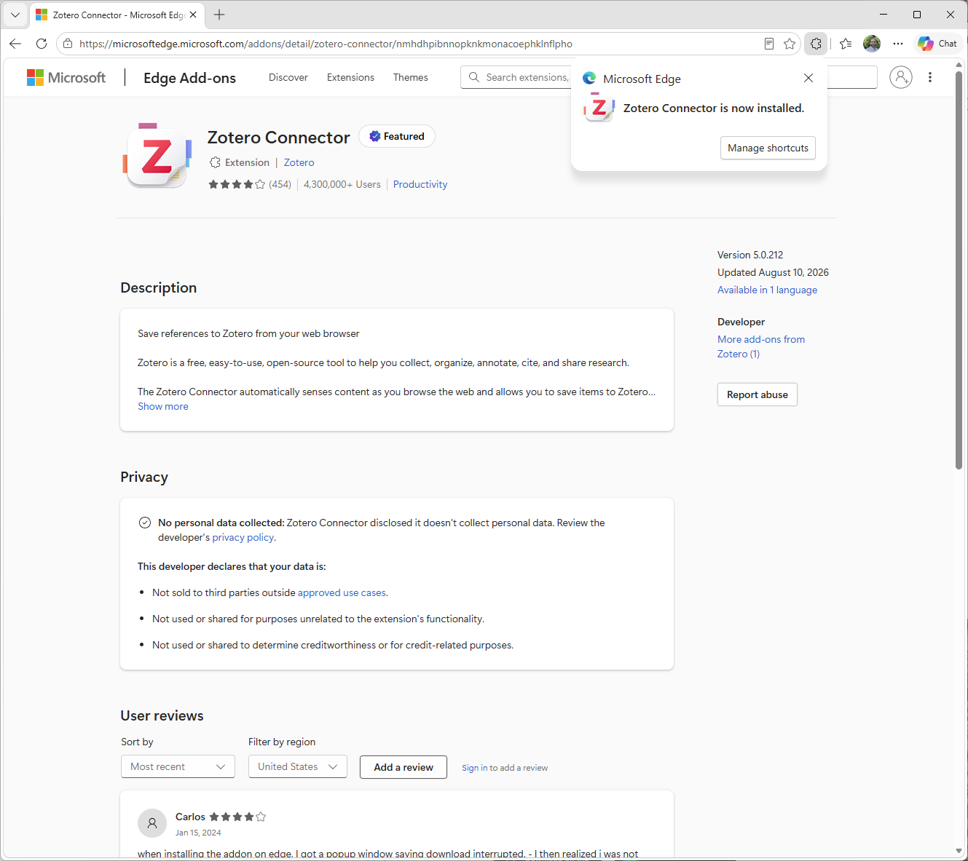
Notes:
A dialog box will tell you that the connector is now installed. Click on the extensions icon (looks like a jigsaw puzzle piece).

Slide 24
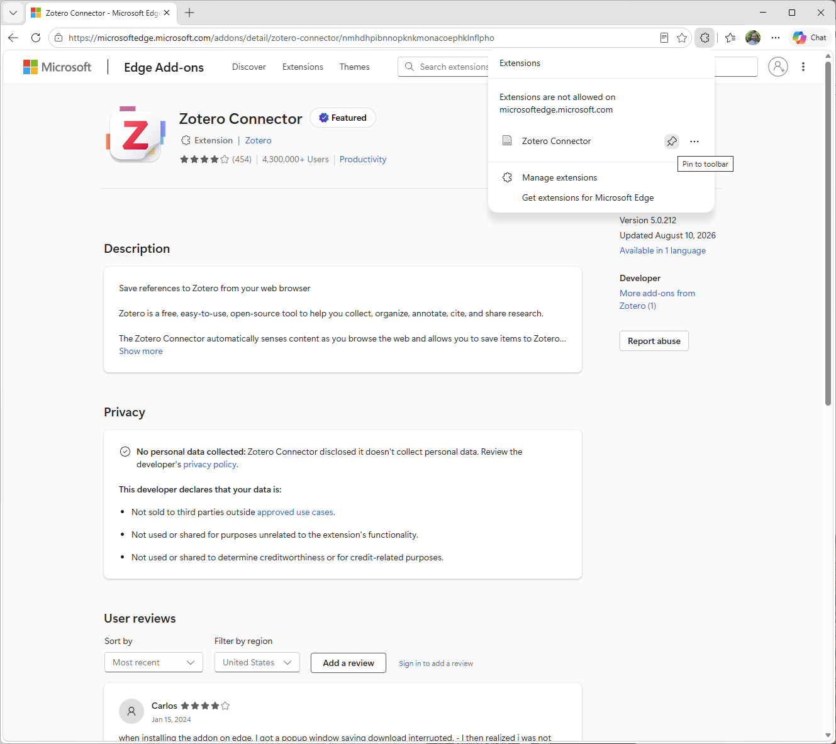
Notes:
- This will show you a listing of all of your extensions. Next to the Zotero Connector is a push-pin icon. Click on that to pin the Zotero icon to your toolbar. You will want to do this.

Slide 25
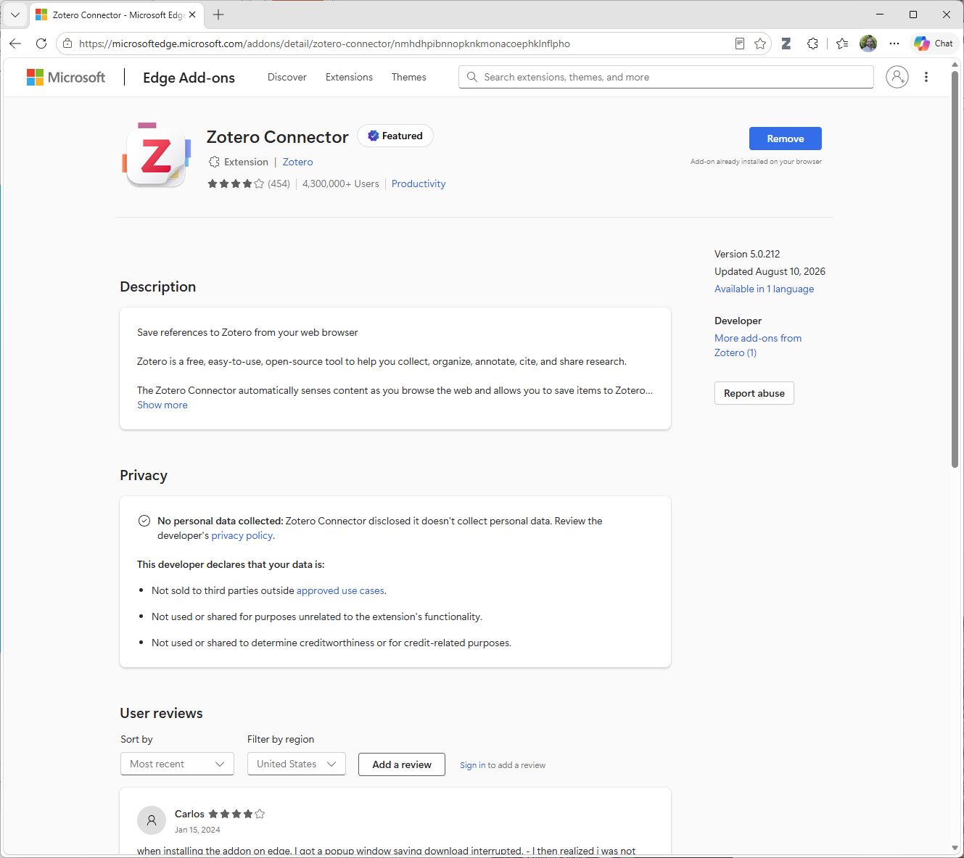
Notes:
- Ta-Da! Note the Zotero icon in the toolbar.

